Slide 1
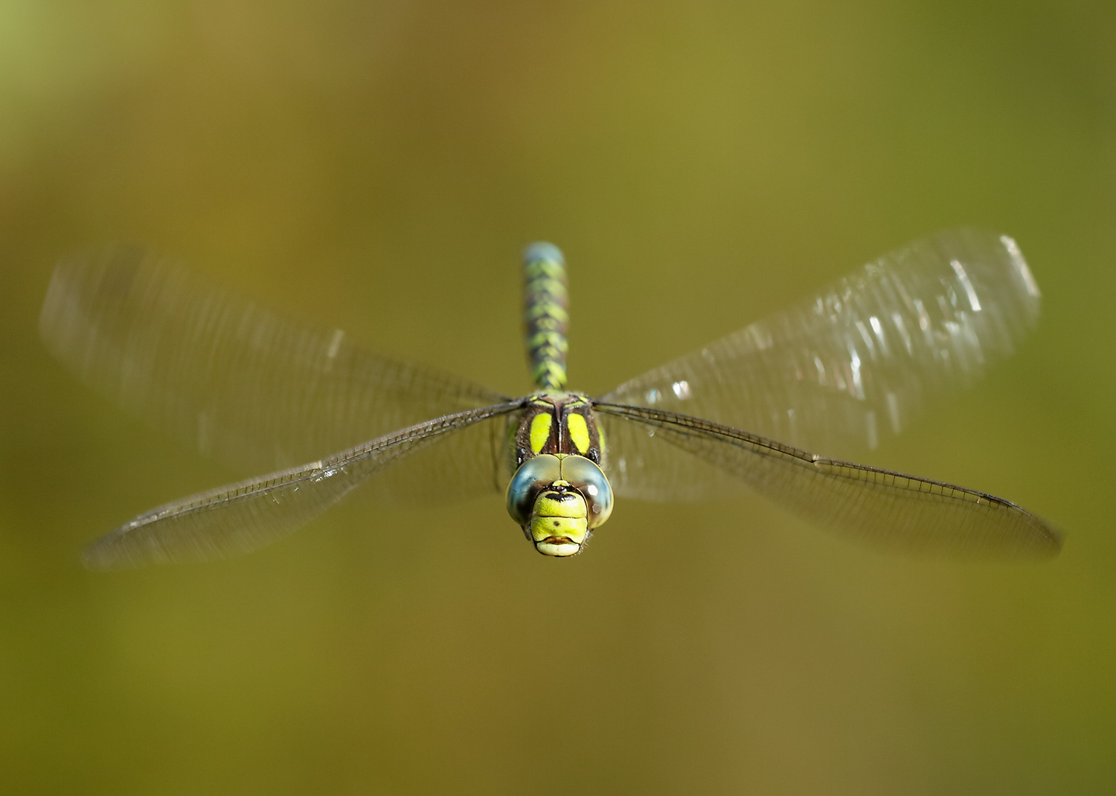
Evolution and the Importance of Biodiversity
©Iain Leach
with Dragonfly Case Studies and Activities
Notes:
Photo credit Iain Leach

Slide 2
Education Pack Information
This presentation seeks to cover the following aspects of the Key Stage 3 curriculum:
The variation between species and between individuals of the same species means some organisms compete more successfully, which can drive natural selection.
Changes in the environment may leave individuals within a species, and some entire species, less well adapted to compete successfully and reproduce, which in turn may lead to extinction.
The importance of maintaining biodiversity and the use of gene banks to preserve hereditary material.

Slide 3
British Dragonfly Society Background Information
What else can the BDS offer staff and students?
Further information on Dragonflies and their wetland habitats
Downloadable resources and handouts
Free leaflets on UK Dragonfly identification to order
Advice and guidance regarding local Dragonfly sites.
For more information, and to get in touch, visit: www.british-dragonflies.org.uk

Slide 4
Evolution
What is it?
Evolution is a scientific theory that seeks to explain the diversity of life we see on the planet today.
Evolution is the change in the heritable characteristics of species’ populations, over time.
What does it do?
These changes can create differences between populations of the same species. Over time a population can change so much that it becomes a new species!
Notes:
Notes:
Key words:
Theory: a system of ideas intended to explain something
Heritable: can be inherited by offspring from their parents

Slide 5
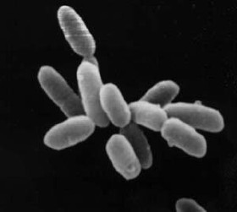
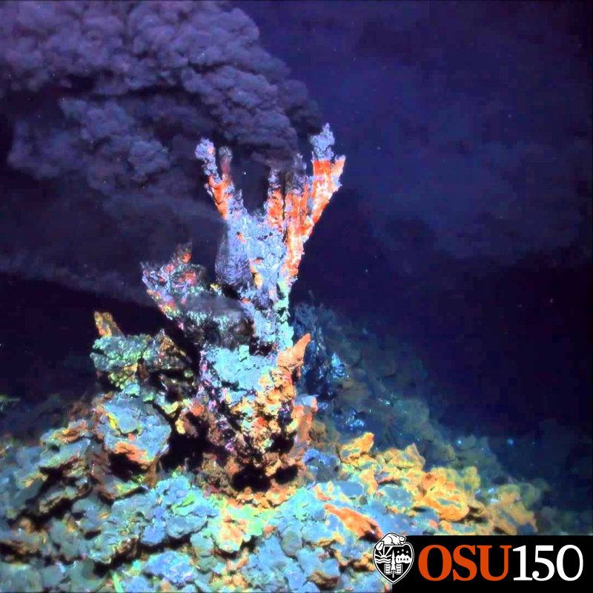
Evolution
The earliest known life forms on earth were microorganisms that lived around underwater hydrothermal vents!
©NASA
Notes:
Notes:
Say hello to your ancient ancestor!
Hydrothermal vents are fissures in the earth surface where heat escapes and heats the water – like a water volcano!

Slide 6
Insects – Dragonflies evolved from this branch of the tree of life.
Mammals – we evolved from this branch, much later than many other species!
Earliest life forms (microorganisms) that everything else evolved from
Notes:
Notes:
Over millions of year these microorganisms and their decedents evolved to create all the species on the earth today- including you!

Slide 7
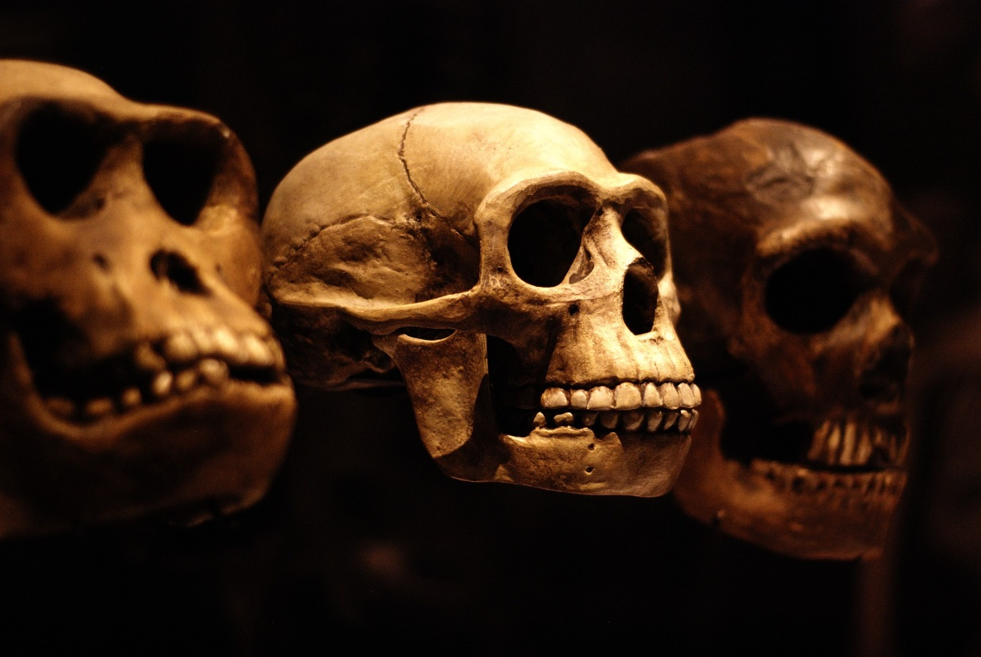
Evolution
What evidence is there?
Bones and fossil records give scientists a window into the past, helping them to explore how species have changed, and how new species have evolved over time.
They can answer questions like. . .
What did the species look like?
How long ago did they live?
When did they first evolve?
But what causes evolution?
© lucyb_22
Notes:
Notes:
Scientists can date fossils by looking at the radioactive properties of minerals and organic matter.

Slide 8
The Theory Of Natural Selection
Evolution is the change. Natural Selection is the cause!
What is it?
Natural Selection is thought to be one of the main causes of evolution. It drives changes in species over time.
Notes:
Notes:
These are the key points of evolution by natural selection:
Individuals in a species show a wide range of variation.
Inherited variation is due to differences in their genes.
Individuals with the features that are best suited to the environment are more likely to survive and reproduce.
The genes that allow these individuals to be successful are passed to their offspring.
Individuals that are poorly adapted to their environment are less likely to survive and reproduce. This means that their genes are less likely to be passed to the next generation.
Over many generations these small differences add up to the new evolution of species.
Given enough time, a population may change so much it may even become a new species, unable to reproduce successfully with individuals of the original species.

Slide 9
Natural Selection
How does it work?
Within any species you find a range of variations e.g. size and colour. These variations are caused by genetic variations between individuals.
Notes:
Notes: Animations on diagram

Slide 10
Natural Selection
2. Genes are passed on when an individual reproduces. As a result the offspring inherit variation from their parents.
Notes:
Notes: Animations on diagram

Slide 11
Natural Selection
3. Some individuals have genes that produce characteristics that provide them with a better chance of surviving and reproducing within a certain environment. These individuals will produce more offspring and, as a result, will be more successful at passing on their genes.
Notes:
Animations on diagram

Slide 12
Natural Selection
4. Some individuals will have genes that create variations that provide them with a low chance of surviving and reproducing. These individuals will produce no or less offspring and, as a result, will be less successful at passing on their genes.
©Vecteezy.com
Notes:
Notes: Animations on diagram

Slide 13
Natural Selection
4. Some individuals will have genes that create variations that provide them with a low chance of surviving and reproducing. These individuals will produce no or less offspring and, as a result, will be less successful at passing on their genes.
Notes:
Notes: Animation on diagrams

Slide 14
Natural Selection
5. Over time, the successful genetic variations will become more prominent in the species.
Notes:
Notes: Animation on diagrams

Slide 15
Natural Selection
6. Sometimes these evolutionary changes can be small but over time they can add up to create a new species
Notes:
Notes: This new species: they can no longer interbreed with the species they evolved from
Animation on diagrams.

Slide 16
Activity 1: White-faced Darter Case Study
Video on Youtube
of the life cycle
of Dragonflies
©Tim Coleshaw
Notes:
Notes:
The 15 minute video provides an introduction to the life cycle, behaviour and ecology of dragonflies.
Please check YouTube for adverts and suitability before launching the video.

Slide 17
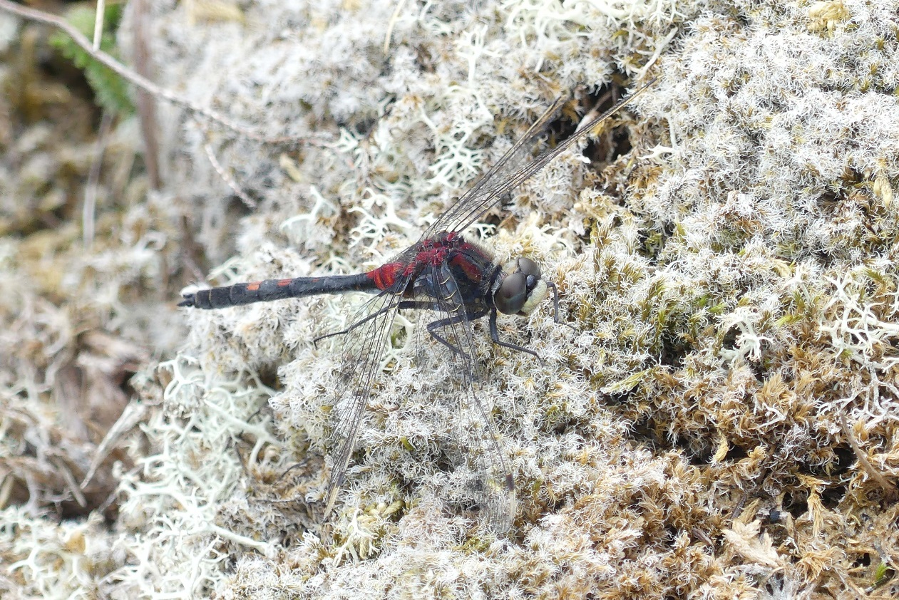
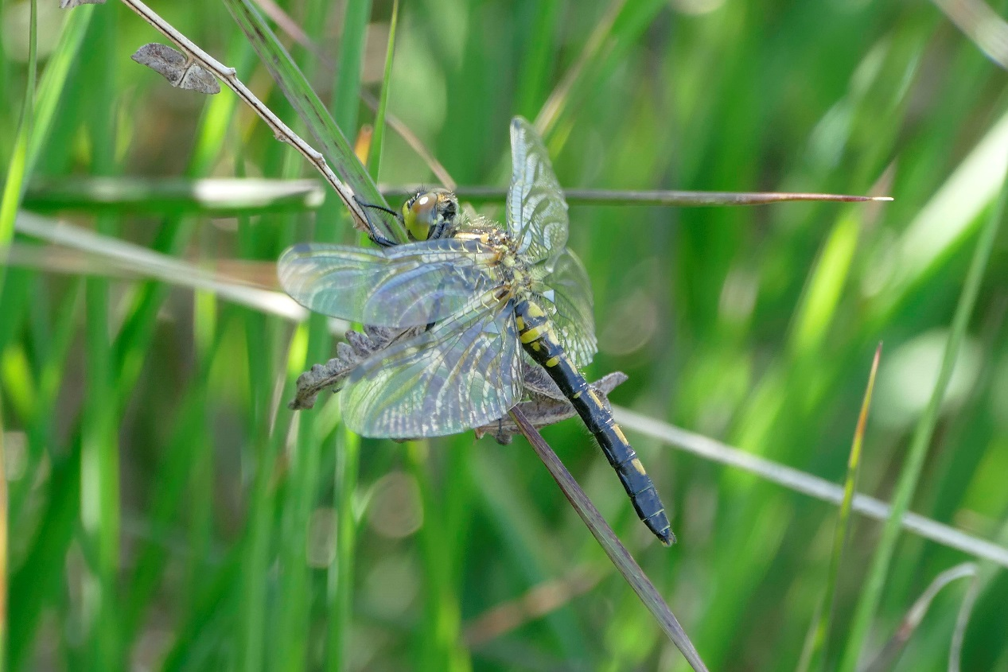
Activity 1: White-faced Darter Case Study
What is a White-faced Darter?
White-faced Darter is a small dark species of Dragonfly, with a pale creamy white face!
© David Turrell
Notes:
Notes: Males have red markings and females have yellow markings

Slide 18
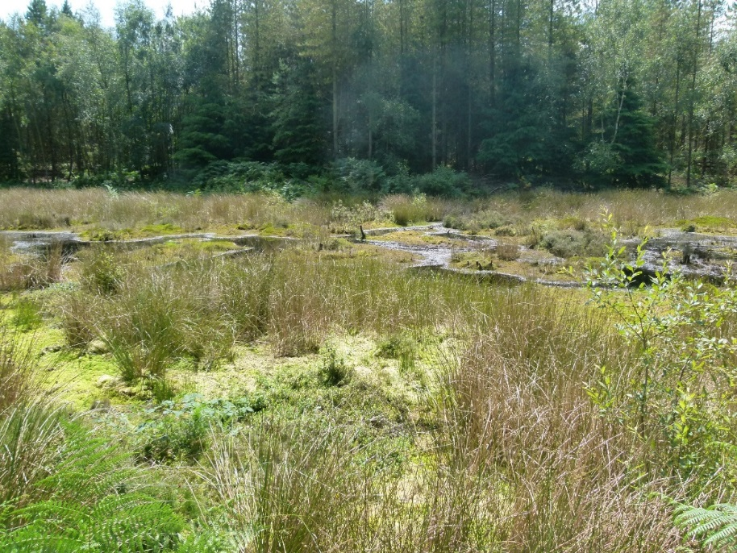
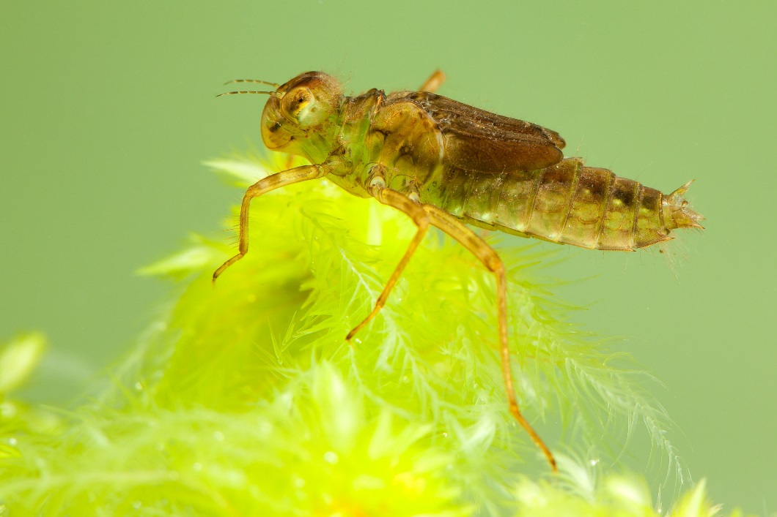
Activity 1: White-faced Darter Case Study
Where does it live?
They breed in lowland bog pools.
Their aquatic larvae (young) live underwater in floating bog moss.
Dragonfly larvae are predators that eat other aquatic creatures.
After 2-3 years the larvae emerge as adults.
© Christophe Brochard
Notes:
Notes: This rare species of Dragonfly is only found in northern Scotland and a few sites in England.

Slide 19
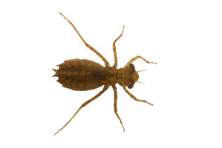
Activity 1: White-faced Darter Case Study
A scientist finds 2 bog pools containing White-faced Darter larvae.
One has fish in, the other one does not.
©clipartmax
Notes:
Notes: This activity is based on a real life scientific study! Can you come to the same conclusion as the scientists?
Flenner, I., Olne, K., Suhling, F. and Sahlén, G. (2009) Predator-induced spine length and exocuticle thickness in Leucorrhinia dubia (Insecta: Odonata): a simple physiological trade-off? Ecological Entomology, 34: 735-740.

Slide 20
Activity 1: White-faced Darter Case Study
Observation: The larvae in the fish pool have larger spines than those in the pool without fish.
Why?
Discuss with the person sat next to you how evolution driven by natural selection could have resulted in this observation.
Complete work sheet 1.
©Christophe Brochard
Notes:
Notes: This activity is based on a real life scientific study!
Flenner, I., Olne, K., Suhling, F. and Sahlén, G. (2009) Predator-induced spine length and exocuticle thickness in Leucorrhinia dubia (Insecta: Odonata): a simple physiological trade-off? Ecological Entomology, 34: 735-740.

Slide 21
Activity 1: White-faced Darter Case Study
Answers
1. Within White-faced Darter larvae you find a range of variation in ______________________. These differences are caused by ___________ variations between individuals.
2. ________ are passed on when an individual reproduces. As a result, offspring ____________ variations from their parents.
spine length
genetic
Genes
inherit
Notes:
Notes: Teacher to ask the class the following questions

Slide 22
Activity 1: White-faced Darter Case Study
Answers
3. Some White-faced Darter _________ have genes that produce __________________ that provide them with a better chance of surviving in ponds with ____________ because ____________________________________________. More individuals with this variation will survive until adulthood and __________________.
4. Some ___________have genes that produce ___________________ that provide them with a low chance of surviving.
larvae
longer spines
fish
they help defend them against predation
reproduce
larvae
short spines
Notes:
Notes: Teacher to ask the class the following questions

Slide 23
Activity 1: White-faced Darter Case Study
Answers
5. What is the natural selection pressure on the larvae? _______________________________
6. What is the evolutionary response? ______________________________________________
predation by fish
evolve longer spines for defence
Long spines are an adaptation!
The larvae have evolved longer spines to adapt to natural selection pressure of fish predation in the pool.
Notes:
Notes: Teacher to ask the class the following questions

Slide 24
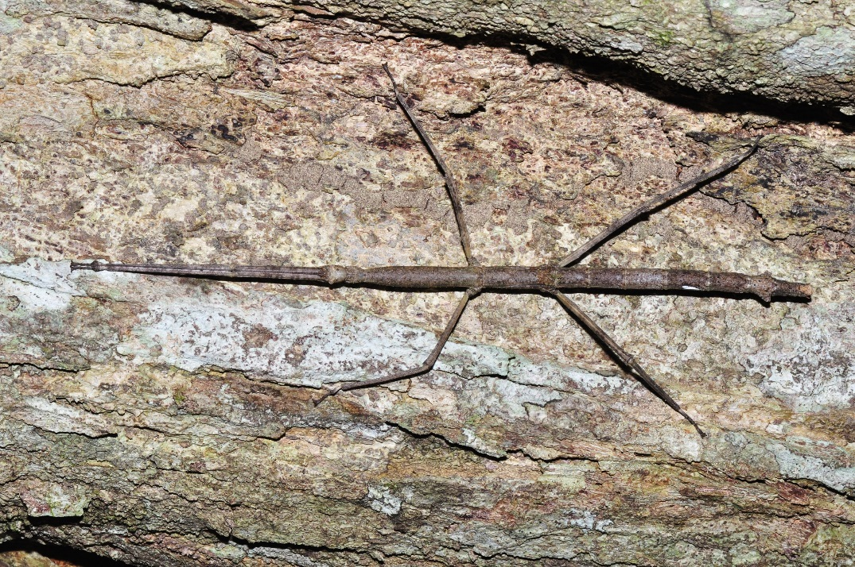
Natural Selection
Adaptations
Natural selection allows species to evolve and adapt to their surrounding environment to give them a better chance of surviving and reproducing.
By looking at how a species interacts with and in their environment it is possible to identify these adaptations.
Evolution is the change.
Natural selection is the cause.
Adaptations are the result.
@Pavel Kirillov
Notes:
Notes: Camouflaged stick insect

Slide 25
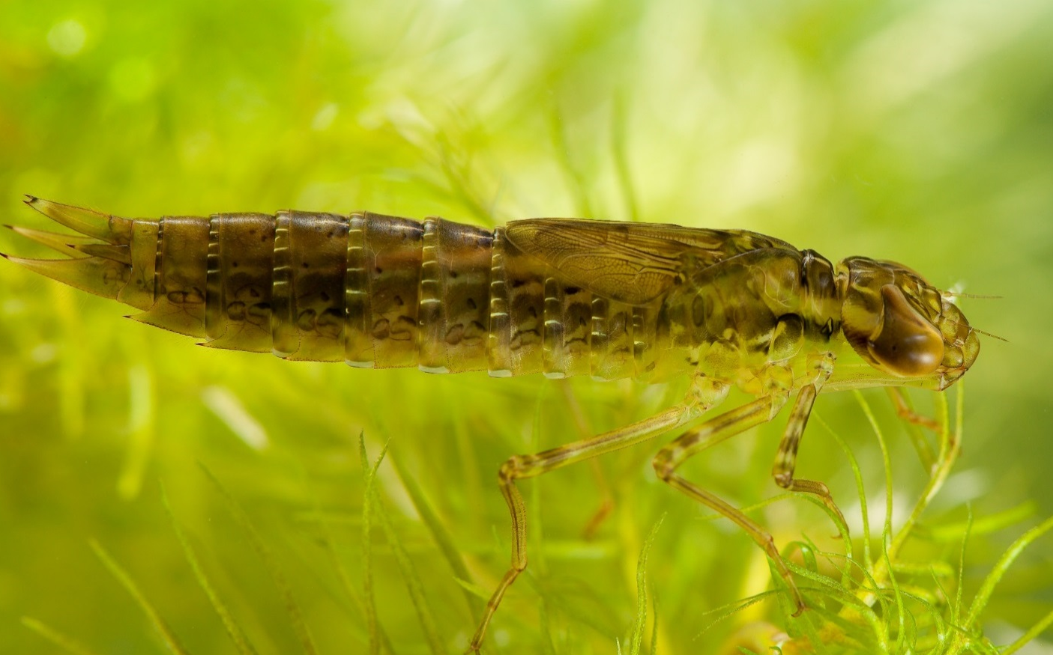
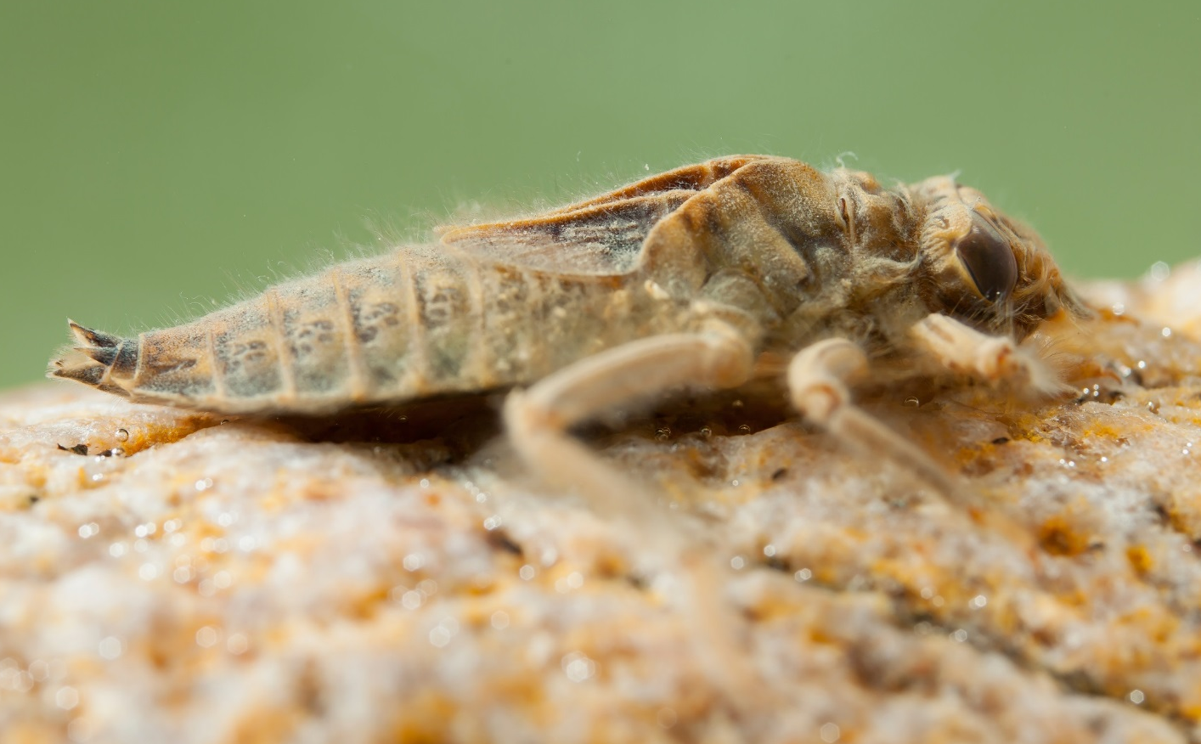
Activity 2: Dragonfly Larvae
Emperor Dragonfly
Common Clubtail Dragonfly
@Christophe Brochard
How are they different?
Notes:
Notes: Here are the larvae of two different species of Dragonfly
Emperor and Common Clubtail.

Slide 26
Activity 2: Dragonfly Larvae
Emperor Dragonfly
Common Clubtail Dragonfly
@Christophe Brochard
Smooth, streamlined body
Large eyes
Flat, hairy body
Smaller eyes
Notes:
Notes: Explain the differences between the two species and point them out on the photos.

Slide 27
Activity 2: Dragonfly Larvae
Emperor Dragonfly
Common Clubtail Dragonfly
@Christophe Brochard
These differences are adaptations to help the larvae hunt and survive in their different habitats.
Notes:
Notes: Ask if anyone can guess what the habitats that each species have adapted to might be like.

Slide 28
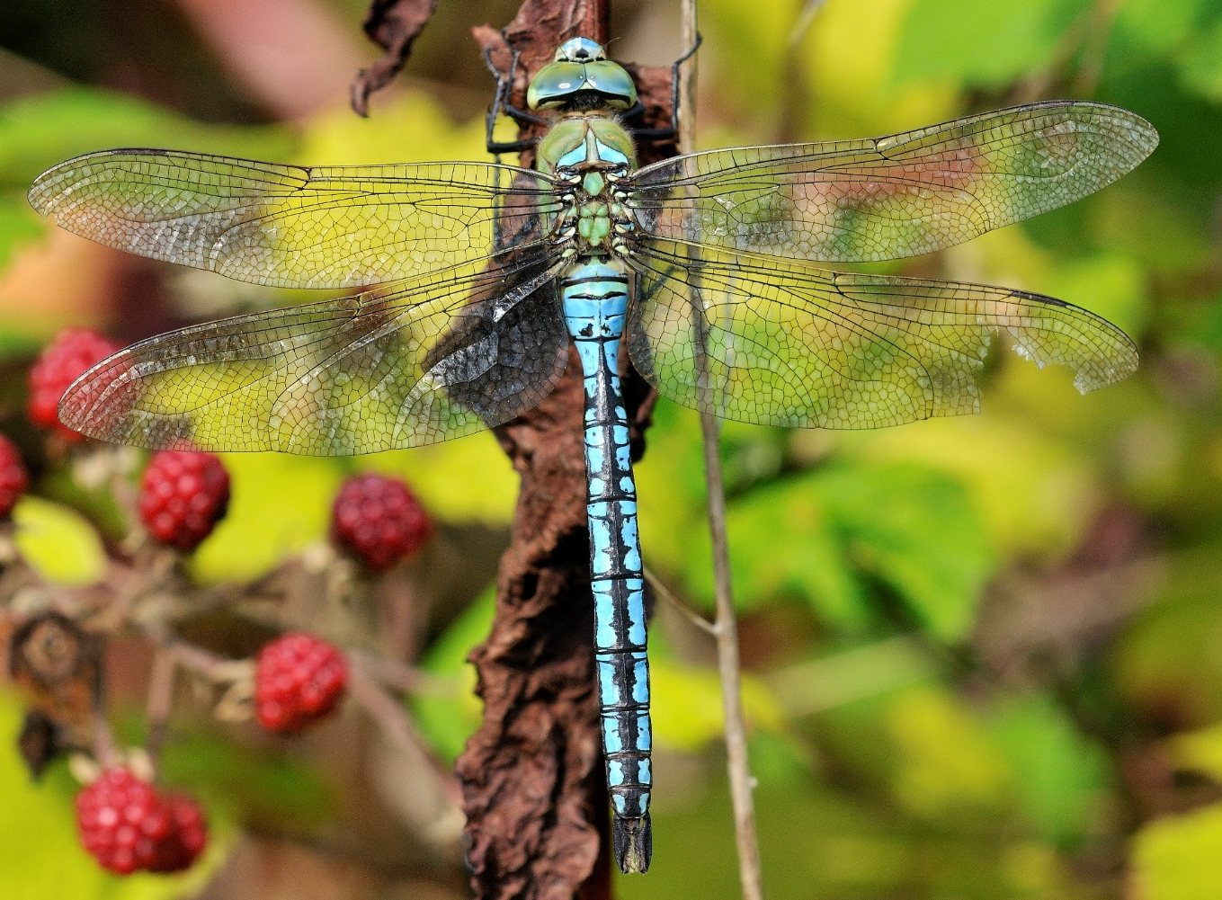
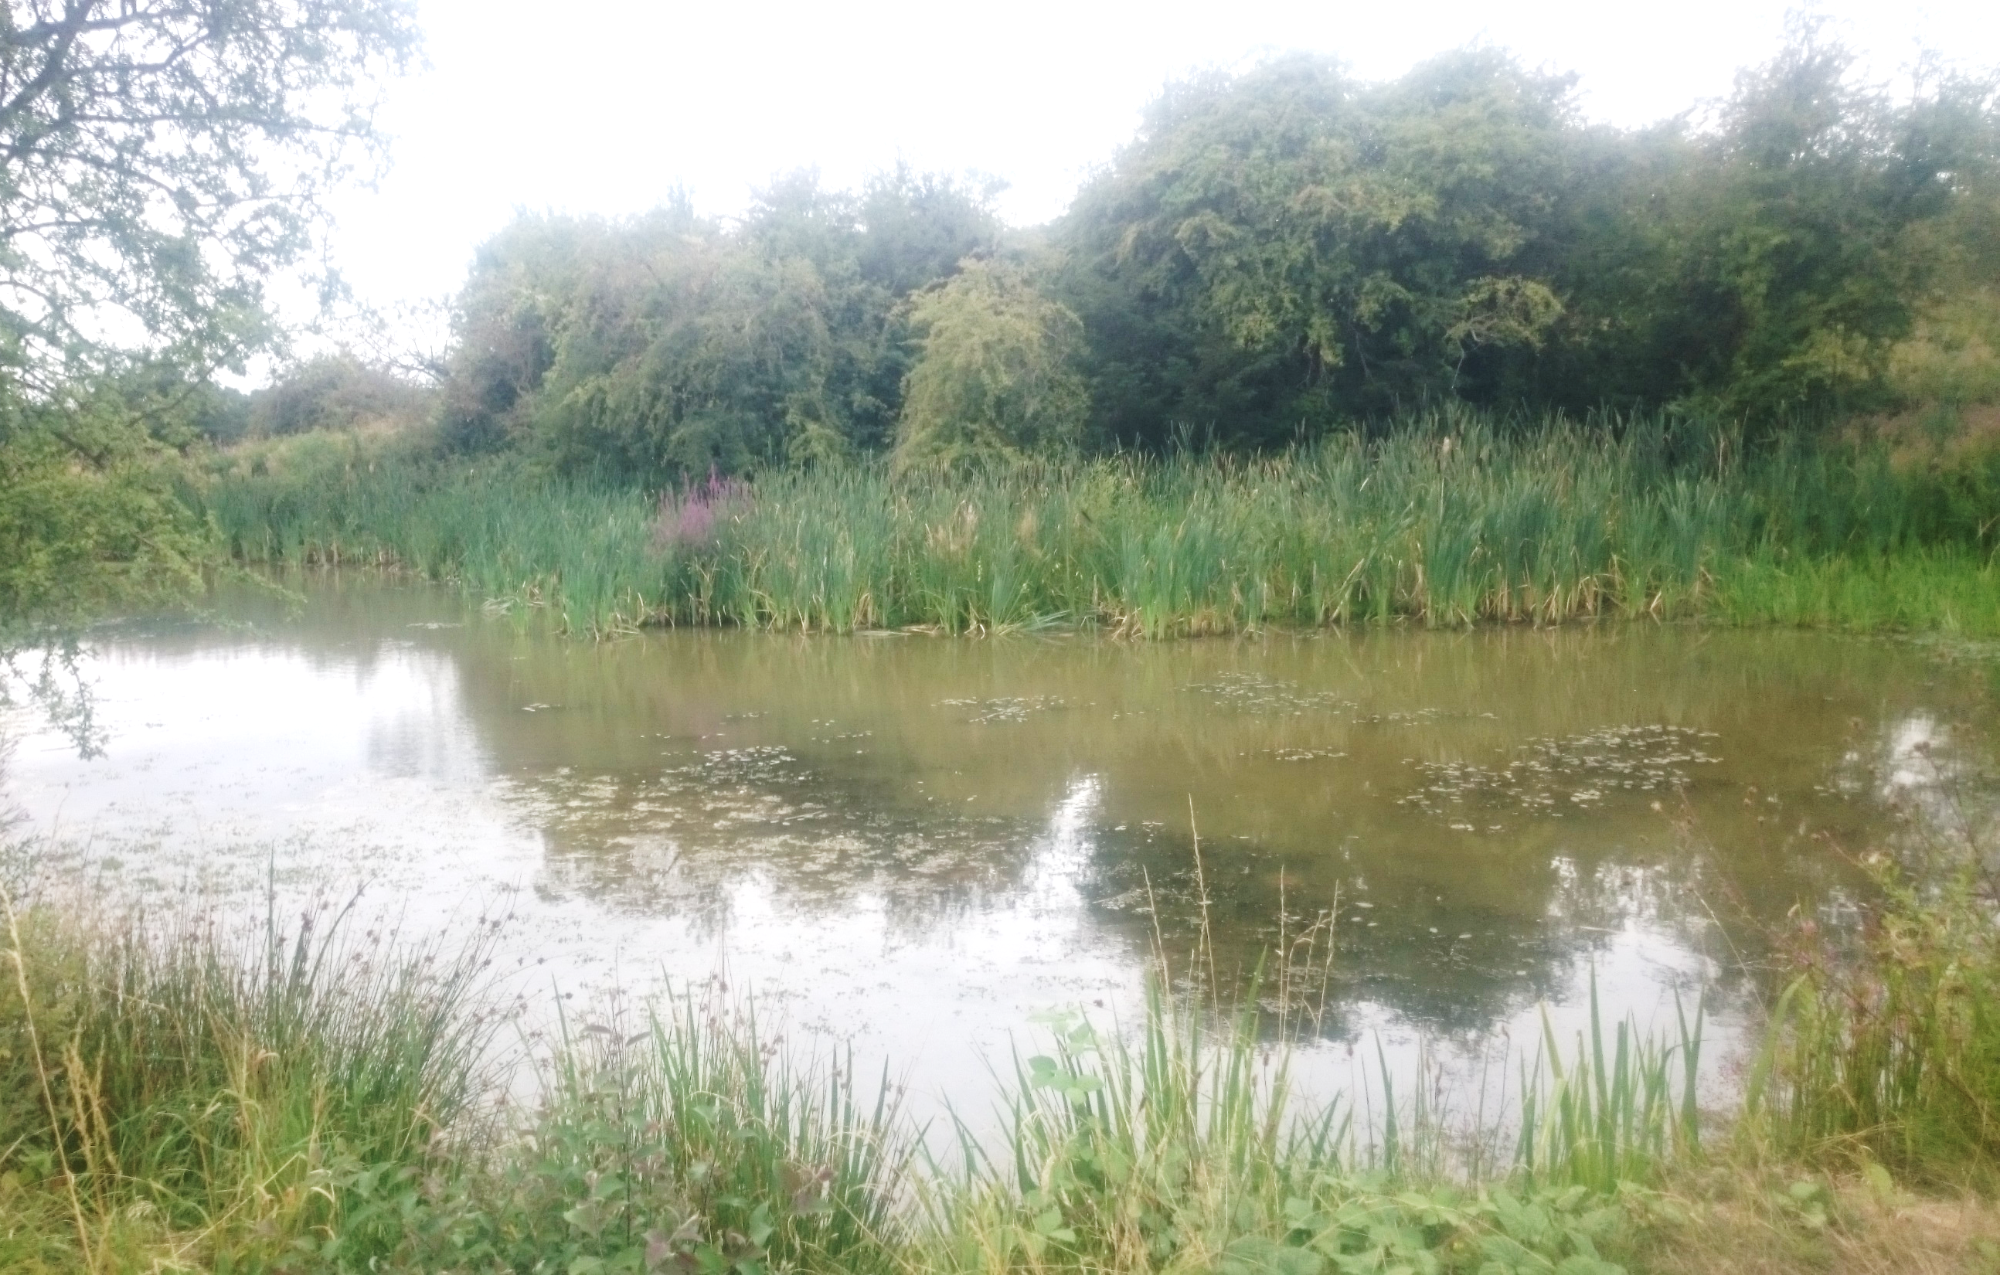
Activity 2: Dragonfly Larvae
Emperor Dragonfly
Live in ponds and lakes with lots of vegetation.
©Gareth Tonks

Slide 29
Activity 2: Dragonfly Larvae
Emperor Dragonfly larvae live in ponds and lakes with lots of vegetation.
They hunt down their prey.
Streamlined and smooth to move
through vegetation.
Large eyes for spotting prey.
©Christophe Brochard

Slide 30
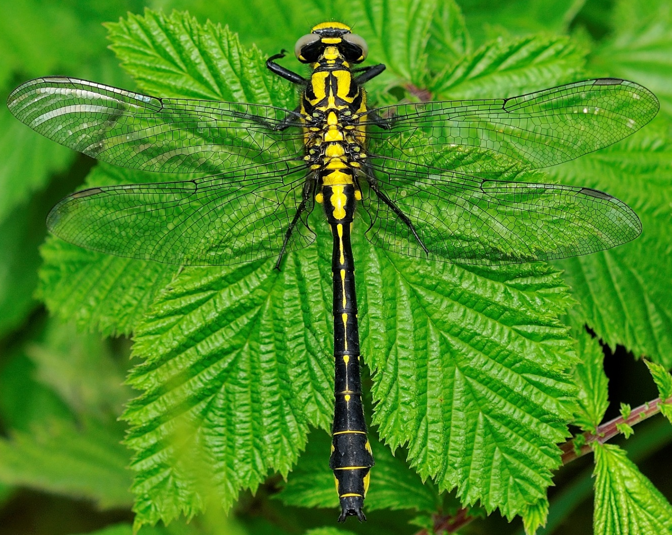
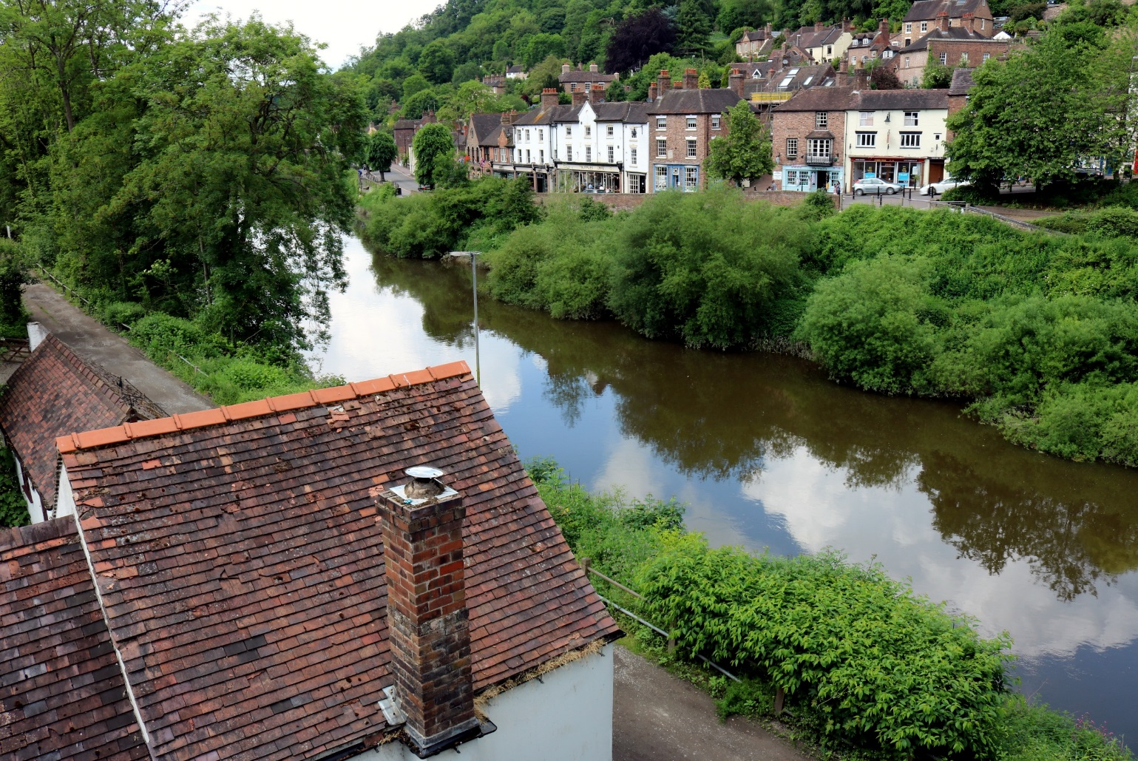
Activity 2: Dragonfly Larvae
Common Clubtail Dragonfly live along rivers.
©Gareth Tonks
©Dan Ashman

Slide 31
Activity 2: Dragonfly Larvae
Common Clubtail Dragonfly larvae live on the bottom of rivers.
They are ambush hunters.
Flat body that allows them to flatten themselves to the river bed to avoid the current.
Hairs that catch sediment
to camouflage them and to sense when prey is close.
©Christophe Brochard

Slide 32
Activity 2: Dragonfly Larvae
You will all have been given or shown an image of a habitat and a description of it.
Your job is to create a Dragonfly larvae!
Design it with its own set of adaptations that will help it to survive and hunt in its habitat. Be as creative as you like!
Hint: Think about. . .
Hunting technique and tools.
Defence and predator avoidance.
Environmental factors/pressures.
Notes:
Notes: Hand out print outs, or show the different habitats on screen and get each group to design a dragonfly larvae for each habitat.

Slide 33
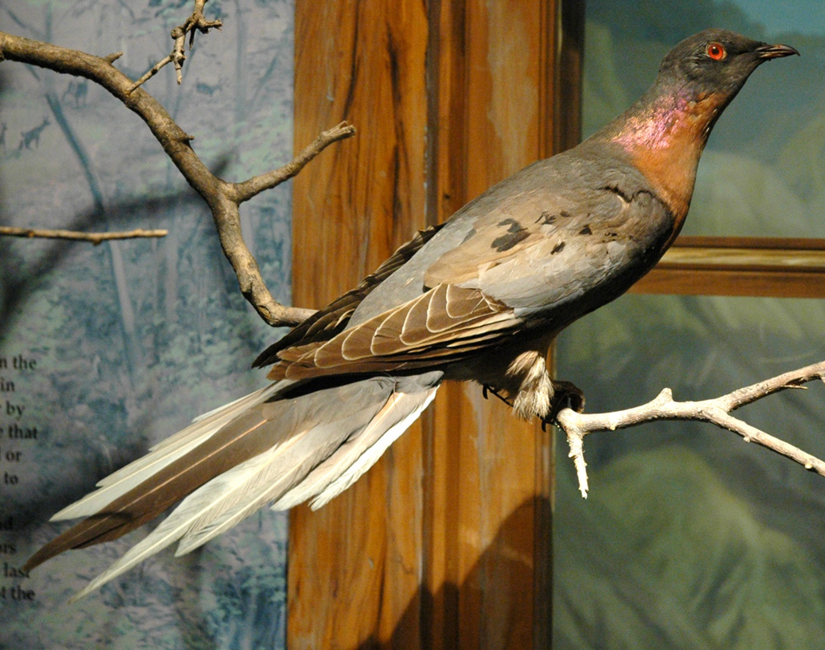
Extinction
Passenger pigeon - extinct
What is it?
A species is extinct when the last known individuals of a species disappear.
What causes extinction?
Extinction is caused by changes within an ecosystem that reduces a species ability to survive and/or reproduce.
©James St. John
Notes:
Notes: Extinct Passenger pigeon – once the most common bird in the USA but went extinct due to unsustainable hunting. People thought that the species was so common and widespread that it could never be depleted. The very last Passenger Pigeon, a female named Martha, died in Cincinnati Zoo in 1914. The species was then officially extinct. https://www.audubon.org/magazine/may-june-2014/why-passenger-pigeon-went-extinct
Ask students to think of other examples of extinct species and what caused extinction– e.g. Dinosaurs, Woolly Mammoth.

Slide 34
Extinction
Can you think of any examples of
causes of extinction?
New predators
Changes in the environment e.g. climate, pollution.
Competition
New diseases
Human © Bob Comix, disease © www.vecteezy
Notes:
Notes:
New predators - Domestic cats are one of the biggest invasive species – they have wiped out species of rodents and birds across the world
Climate Change - Increasing temperatures, caused by more carbon dioxide and ‘greenhouse gases’ being trapped in our atmosphere, are melting the polar ice caps and making it impossible for the polar bears that live on them and survive.
Pollution comes in many forms, from chemicals on farmland washing into streams and rivers, to plastic litter and chemicals reaching our oceans and killing the marine life that eats it.
Competition - Overfishing by humans is threatening seabirds. Many species are killed for eating our crops or our livestock, e.g. elephants are attracted to African villages to eat crops and then are killed by villagers, insects are killed by pesticide chemicals as they eat our crops. Humans also destroy the habitat of many species as we compete for land to grow our food and products on, or to build our homes and roads on.
New disease- amphibians are globally threatened due to spreading fungal diseases. Biosecurity is vital in order to stop new diseases spreading easily around the world. Climate change is also thought to help disease spread as the environment changes.

Slide 35
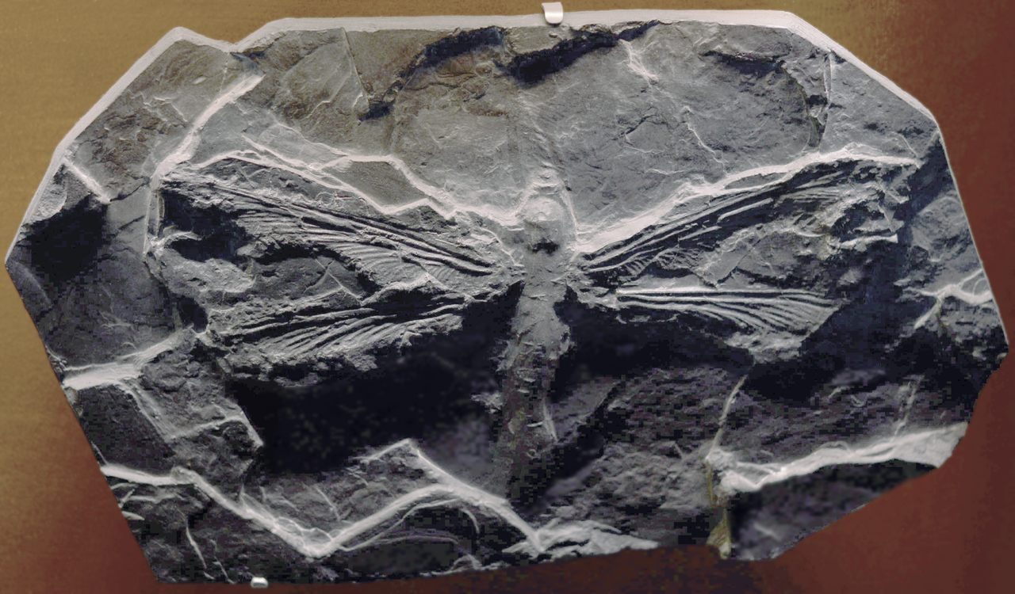
Extinction
Griffinflies
Giant ancient species of Dragonflies- wing span up to 71cm
Went extinct during the late Permian period when oxygen levels in the atmosphere reduced.
The insects’ simple respiratory system could no longer support its large body size with the lower levels of oxygen in the environment.
Video on ancient giant insects
©Alexandre Albore
Notes:
Notes: Permian period was 299 to 251 million years ago

Slide 36
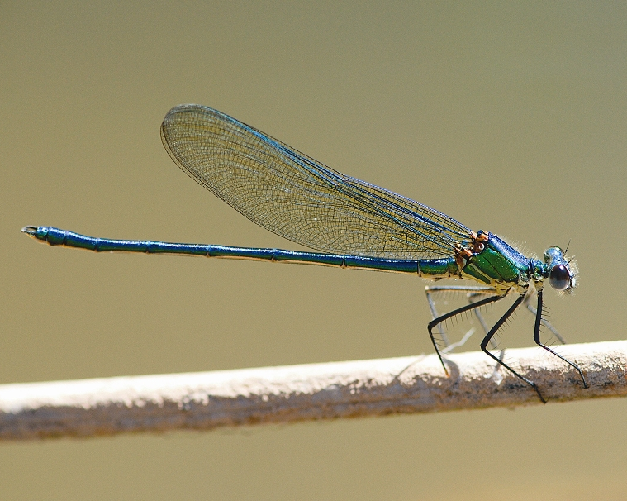
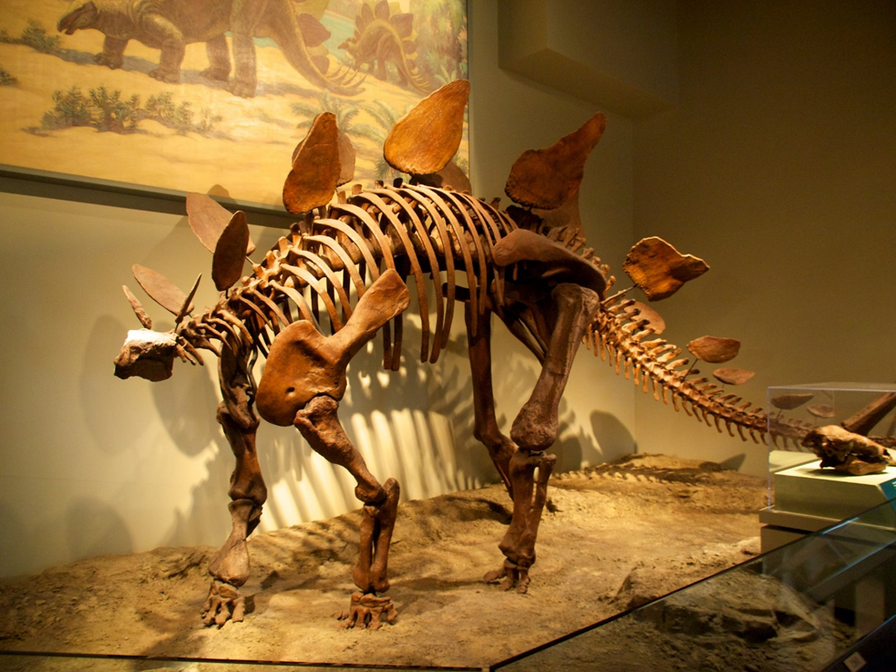
Extinction
What is an endangered species?
A species at risk from extinction.
Glittering Demoiselle – endangered species
What is a mass extinction event?
Widespread and rapid decrease in biodiversity on Earth.
Can you think of any examples of a mass extinction event?
©Yuxuan Wang
©Bernd Kunz
Notes:
Notes:
Glittering Demoiselle – only occurs across the Atlas Mountain area of North Africa. Its natural habitat is along rivers, which are threatened by pollution, and drying due to water-harnessing for human use, irrigation, climatic fluctuations and drought.
Worldwide there are 97 species of dragonfly and damselfly that are classed as endangered. Some British species are doing well across the rest of their range in Europe, but are considered ‘endangered’ in the UK as their numbers have fallen so much; the Southern Damselfly is an example of this.
Can students think of any well known endangered species? E.g. Tiger, Polar Bear, Giant Panda, Orang-utan, Gorilla, Blue Whale, Chimpanzee.
Dinosaurs were an example of a mass extinction event.

Slide 37
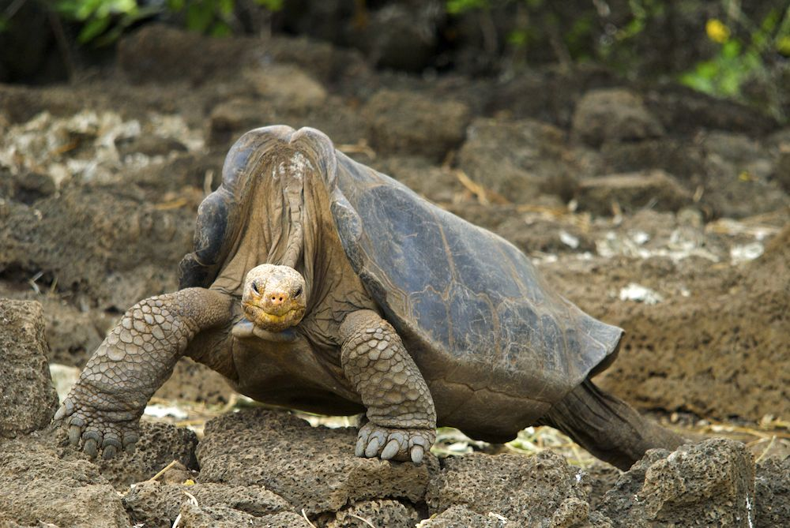
Extinction
The 6th mass extinction event is happening now
Extinction is currently 100 to 1,000 times higher than natural background rates. Unlike previous mass extinction events, this one is being driven by human
activity.
Lonesome George
- the last Pinta Island tortoise, died in 2012, age 101 years old. This species was wiped out by over hunting by humans.
©Arturo de Frias Marques
Notes:
Notes:
6th mass extinction event -Unlike past mass extinctions, caused by events like asteroid strikes, volcanic eruptions, and natural climate shifts, the current crisis is almost entirely caused by us — humans. In fact, 99 percent of currently threatened species are at risk from human activities, primarily those driving habitat loss, introduction of exotic species, and global warming
The famous Lonesome George-the last Pinta Island tortoise, died in 2012, 101 years old. They were wiped out by humans due to over hunting.

Slide 38
Threatened species
The IUCN Red List of Threatened Species™ is the world's most comprehensive inventory of the global conservation status of plant and animal species.
www.iucnredlist.org
They rate species vulnerability to extinction based on population size and the rate of decline.

Slide 39
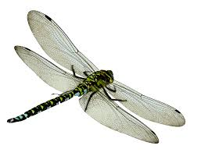
Activity 3: Threatened Dragonfly Species Investigation
Use our website to help you investigate a species that is threatened enough to be on our nationally important list and fill in the blank factsheet.
https://british-dragonflies.org.uk/content/conservation
You need to draw your species and provide information on its:
Range (where is it found)?
Habitat
Threats
Conservation

Slide 40
Biodiversity
What is biodiversity?
The variety of life found in a place on Earth or, often, the total variety of life on Earth – it is also called biological diversity.
We look at genetic diversity, species diversity and diversity at ecosystem level.
Why is it important to maintain biodiversity?
© Barta IV, flickr
Notes:
Notes: allow students to put forward any answer to the second question, then go through the next slides to see if they thought of any of the answers.

Slide 41
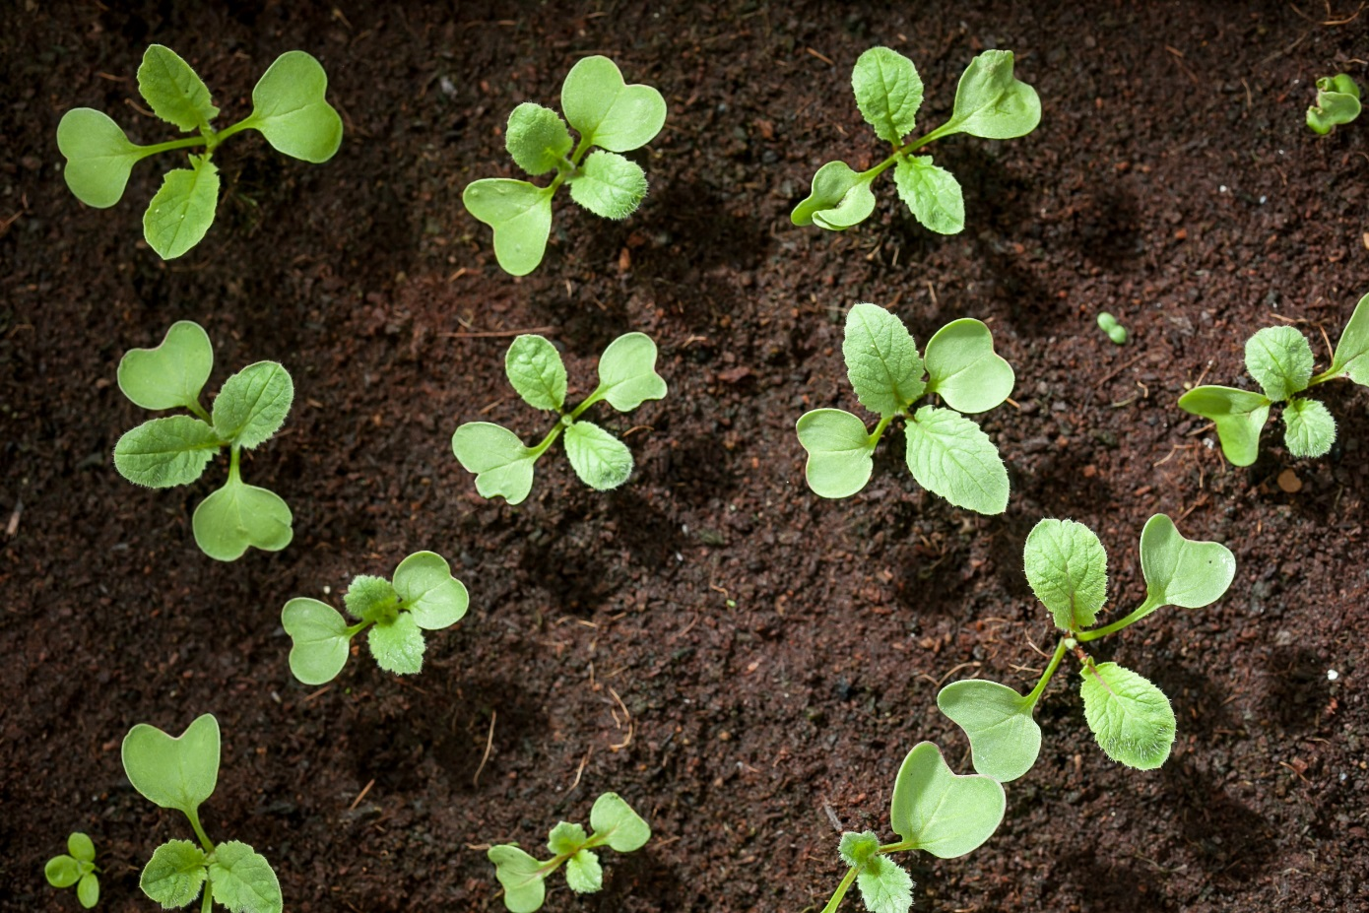
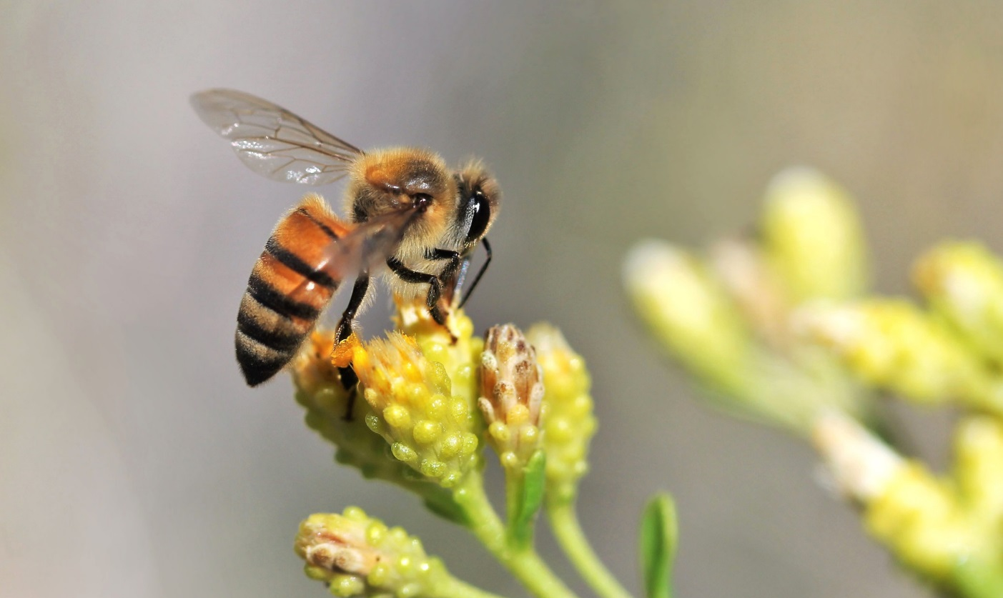
Biodiversity
Ecosystem services are the many and varied benefits that humans freely gain from the natural environment and from properly functioning ecosystems.
Such as:
Healthy soil
Pollination
Stable climate
©Chia Ying Yang
© Renee Grayson
Notes:
Ecosystem: a biological community of interacting organisms and their physical environment. More commonly described as a complex network or interconnected system.
Ask why students why these benefit are important for humans?
Healthy soil - Important for agriculture and food production. Dependents on microorganisms and invertebrates turning organic matter into nutrients for plants.
Pollination - Insects pollinate our crops
Stable climate – Long periods of drought threatened our food and water supplies. Flooding damages our infrastructure.
Forests play an important part in maintaining a stable climate by absorbing and storing Carbon Dioxide, as well taking water deep into the ground through their roots, slowing the flow of flood water and stabilising river banks and so preventing bankside erosion and associated pollution from silt entering rivers and streams.

Slide 42
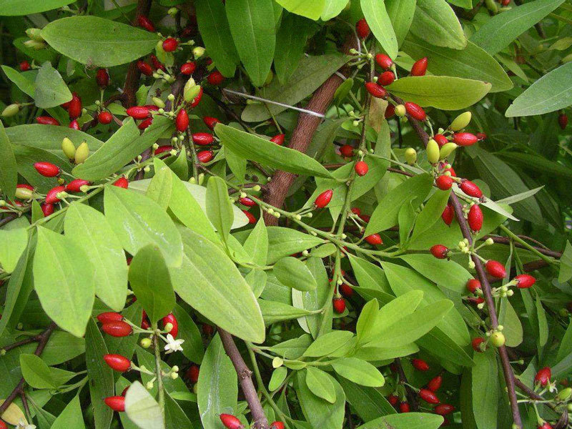
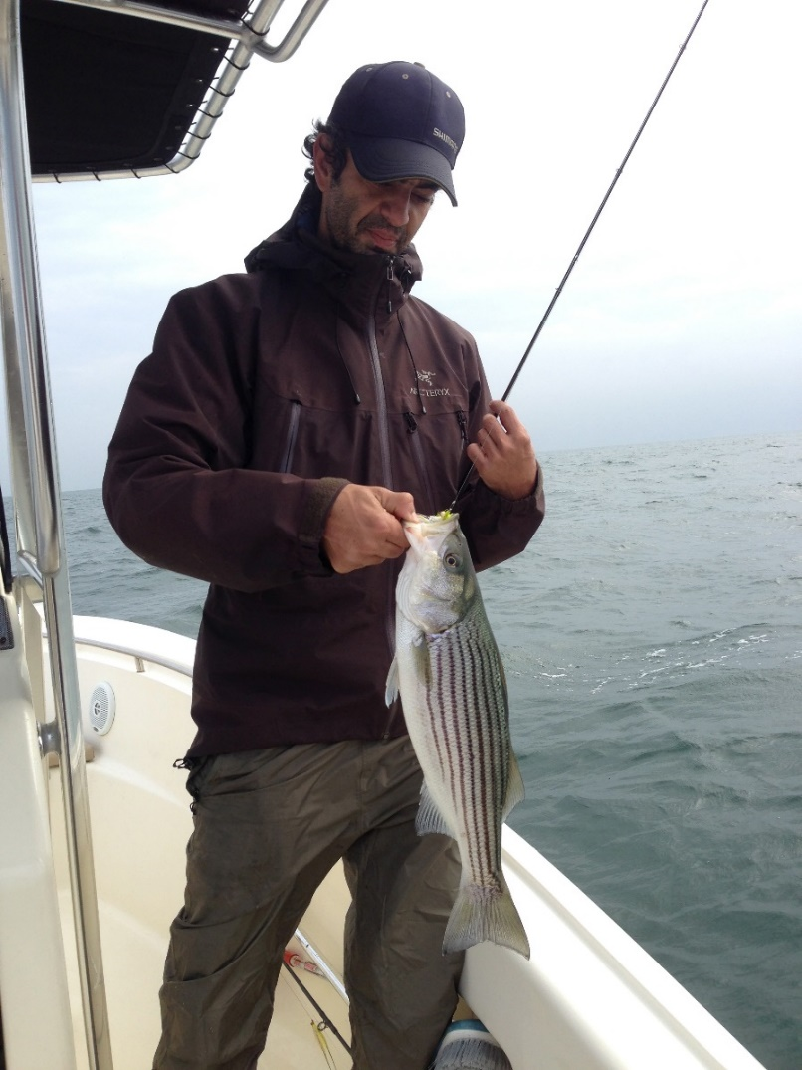
Biodiversity
We need biological resources such as . . .
Food
Medicine
Materials
© Ilmari Karonen
©Luyen Chou
Notes:
Notes:
Food - e.g. plants, herbs, fish, shellfish.
Medicine. -The chemicals in a lot of the medicines we use today are derived from natural sources e.g. cocoa plant extracts are used to lower blood pressure, and Aspirin comes from salicylate, which can be found in plants such as willow trees and myrtle. Aspirin was the first non-steroidal anti-inflammatory drug (NSAID) to be discovered.
Materials – wood has been used by humans to build homes, boats, carts, farming equipment. In modern times we still rely on minerals such as cobalt mined in African countries to make our touch screens on our smart devices. Sadly the trade in these minerals is often very unethical and is leading to habitat loss and fuelling the ‘bush meat trade’ where workers kill and eat endangered animals in order to survive and sometimes to make extra income by selling this meat.

Slide 43
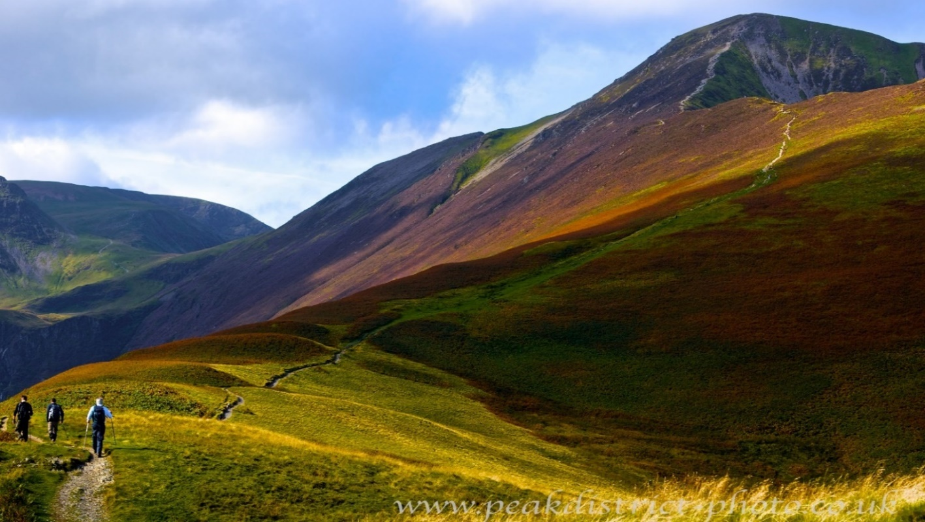
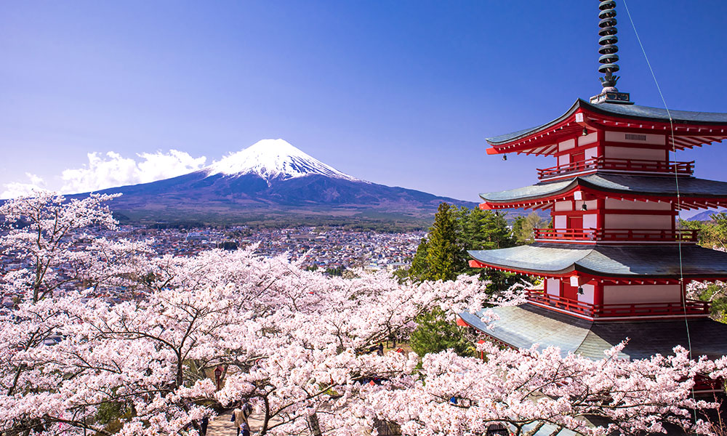
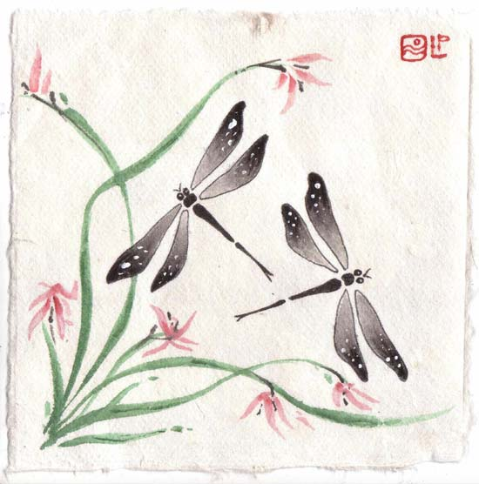
Biodiversity
We also benefit socially from natural resources through . . .
Recreation
Tourism
Cultural values
e.g. Japan is also
known as
Dragonfly Island
©Bob Conner
©JamieMillerDragonfly
©Japan Magazine
Notes:
Notes:
Recreation- The mental and physical health benefits of spending time outdoors with nature are well known. Ask students what outdoor activities they enjoy?
Tourism - Nature and wildlife tourism provide economic opportunities for local communities. E.g. Peak district national park (top picture) is visited by millions of tourists a year. Provides almost 1000 jobs. Ask students where they like visiting in their free time or on holiday?
Cultural values – Japan is also known as Akitsushima, translated as Dragonfly Island, as it is believed that Japan’s first Emperor, Jimmu (660 BC), once climbed a mountain in Nara, and looking out over the land, claimed that his country was shaped like a dragonfly, or two dragonflies mating.
Samurai Warriors armour, weapons and clothing depicted dragonflies as they saw them as very lucky and admired their hunting prowess. The old (Pre Meiji era) word for dragonfly was Katchimushi. “Katchi” means “To win”, hence dragonflies were seen as auspicious by the samurai.
One of Japan’s staple crops is rice, which requires the same water habitat of the dragonfly. Therefore the dragonfly is often associated with the rice paddies of Japan and with that the nostalgia of growing up in a farming community tied to the land.
This nostalgia is represented in the inclusion of the dragonfly image in many forms in Japanese art such as poems/songs, paintings, and on pottery and fabrics (pictured). In addition to the nostalgia represented by the dragonfly there is also a folk belief that the tombo (dragonfly) is the soul of a departed ancestor come back to visit their loved ones. The summer festival of Obon celebrates this sacred event.
Do any species have cultural value where you are? A local mascot for sports teams? School/county emblem?

Slide 44
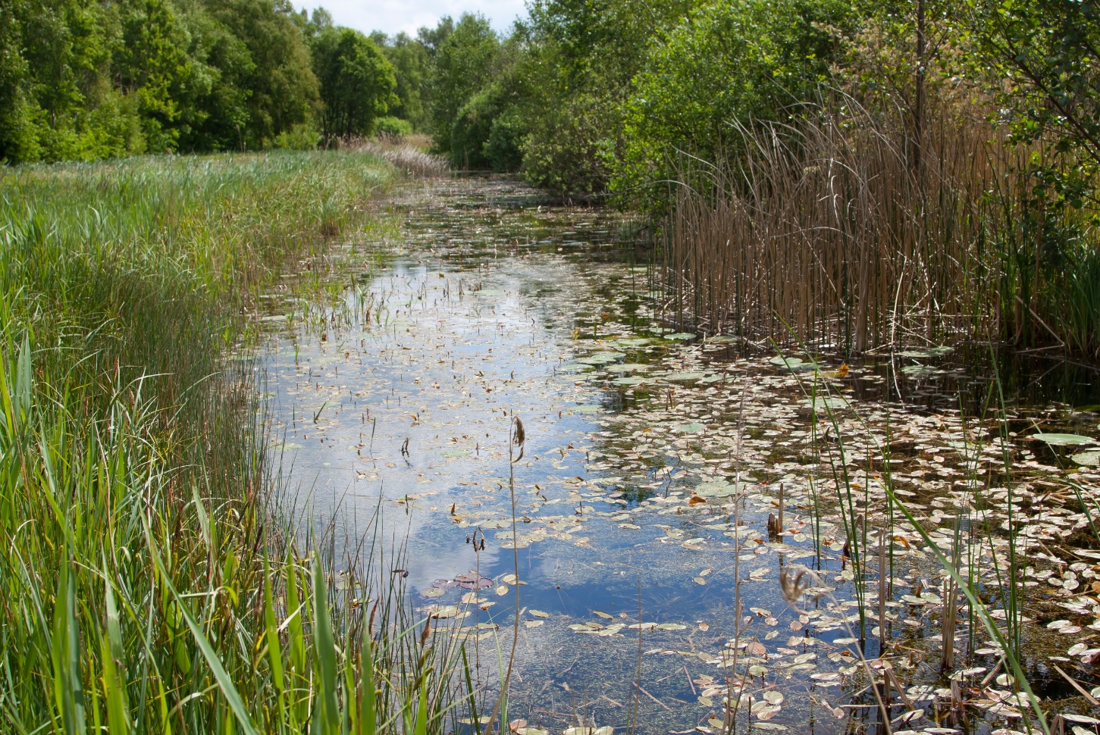
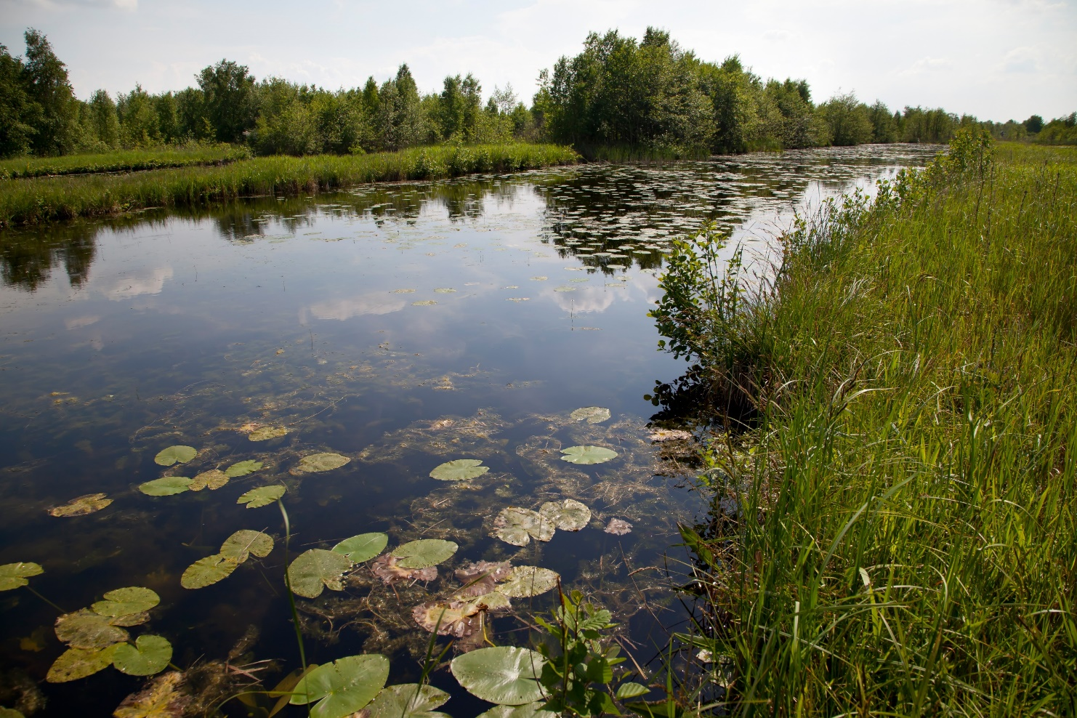
Activity 4: UK Freshwater Habitats
Since the industrial revolution we have lost 90% of our freshwater habitats according to the Wildfowl and Wetlands Trust.
Christophe Brochard
Notes:
Notes: Feel free to add in photos or information about your nearest freshwater habitat.
Ask students what their favourite freshwater habitat is. E.g. garden pond, park lakes, local streams, rivers, or canals.

Slide 45
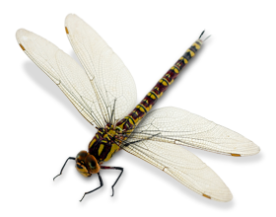
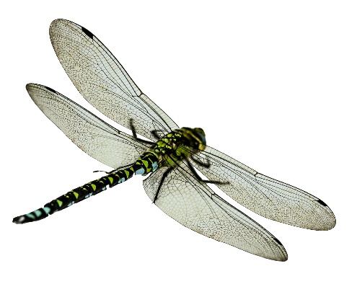
Activity 4: UK Freshwater Habitats
Research freshwater habitats and answer the following questions:
1. What different types of freshwater habitats do you find in the UK?
2. Why are they so important for dragonflies and other wildlife?
3. What is/ has been their value to people in the UK?
Tip: remember the different types of ecosystem services

Slide 46
Biodiversity
Why is biodiversity important?
Because ecosystems need to be resilient to change
The ability of an ecosystem to recover from disturbances e.g. extreme weather events, is called ecosystem resilience.
Ecosystems are complex webs made up of lots of interacting species and environmental factors.
The more species removed and the more environmental factors that are altered the more unstable the ecosystem becomes.
As a result it will less likely be able to recover from disturbances and more likely to collapse.
©Chris, flickr

Slide 47
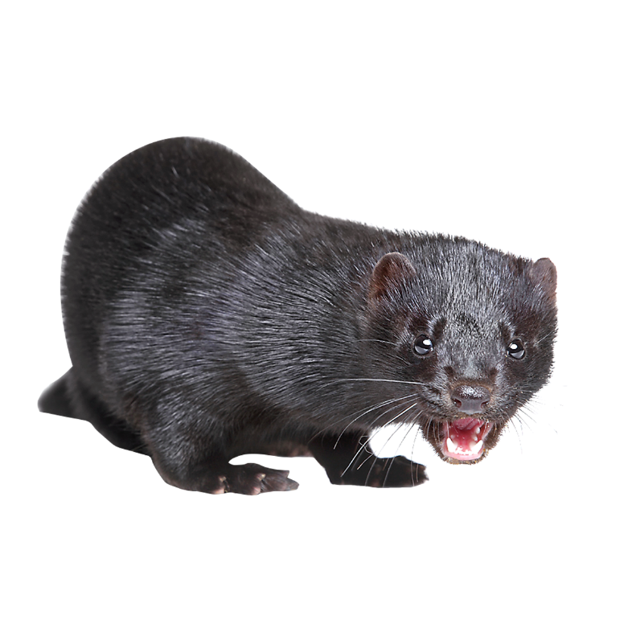
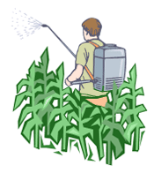
Conservation
Many species in the UK are threatened by extinction because of factors caused by humans, such as:
Habitat destruction
Introduction of non-native invasive species
Pollution
©isvalenvzla
Notes:
Notes:
Habitat destruction e.g. many historic farmland ponds have been filled in, dried up and neglected affecting lots of freshwater species like dragonflies.
Invasive species e.g. water vole are threatened by introduction of American mink which escaped or where released from fur farms.
Pollution e.g. pollinators like bees are declining due to the widespread use of pesticides. Dragonfly species rely on these species for food so are also affected and are also sensitive to pollution. In addition, dragonfly larvae are threatened by water pollution. Endangered species like the Southern Damselfly are particularly threatened as they occur in small numbers and in disconnected pockets of remaining habitat. They cannot disperse quickly and have very specific habitat requirements too. A pollution incident at any of their remaining strongholds could be disastrous for this species.

Slide 48
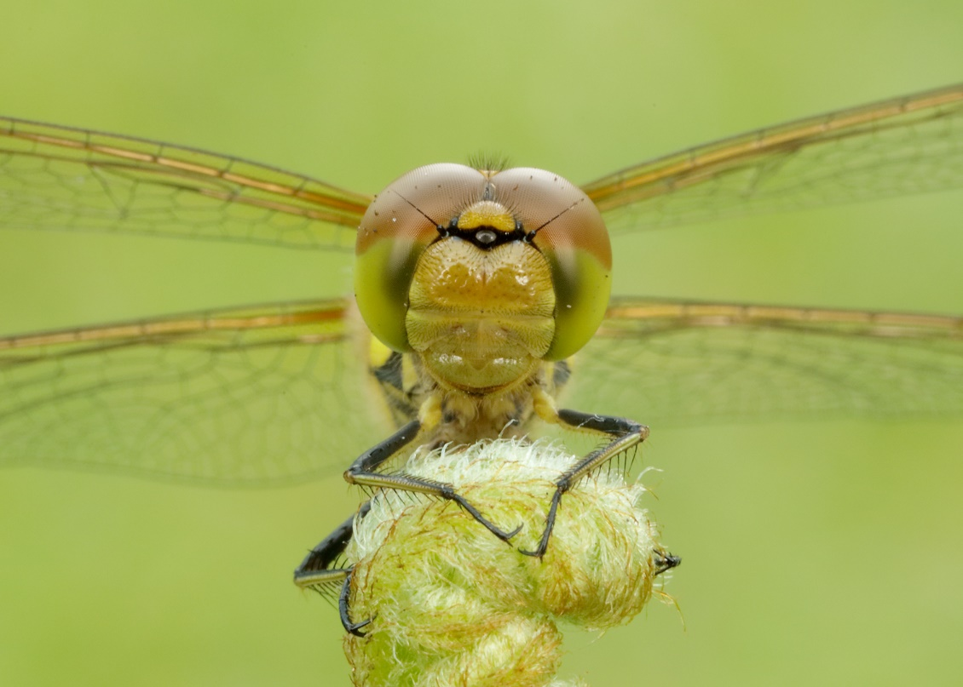
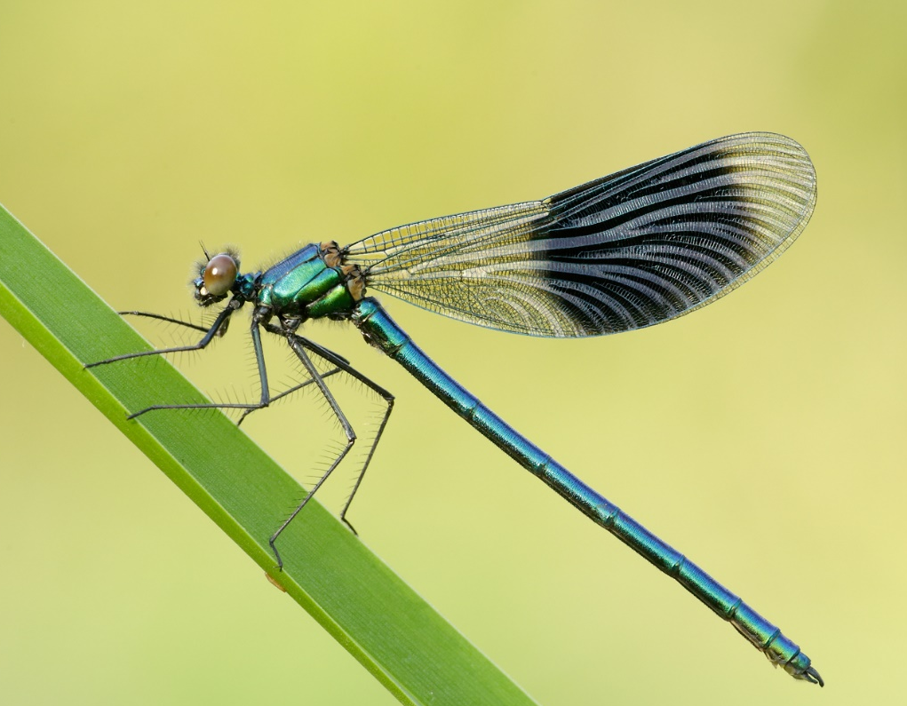
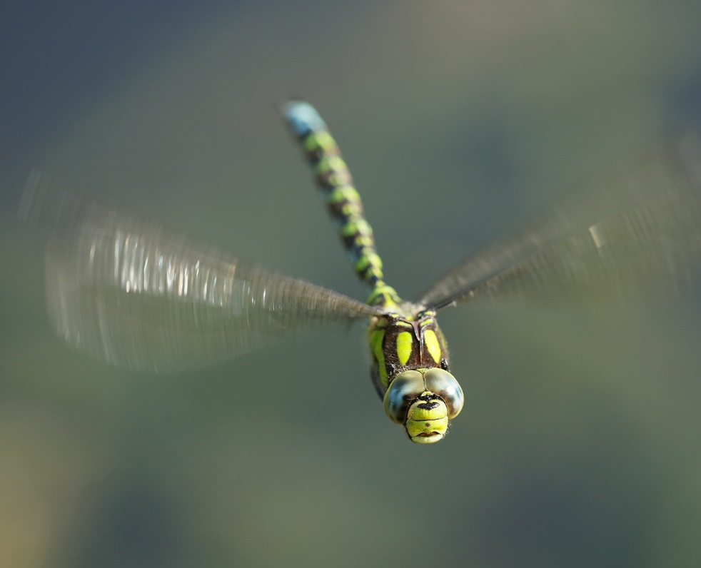
Conservation Case Study: BDS
The British Dragonfly Society - Who are we?
We are a small charity, run predominantly by volunteers, created with the aims of conserving dragonflies and damselflies, and the wetland habitats they rely upon.
Iain Leach
Notes:
Notes: More information here: https://british-dragonflies.org.uk

Slide 49
Conservation Case Study: BDS
Why conserve Dragonflies and their habitats?
Their wetland habitats support high levels of biodiversity.
Wetland habitats provide a wide range of ecosystem services.
Dragonflies are an important part of the food web.
A third of Dragonfly species are vulnerable because they are rare or have a limited distribution.
Notes:
Notes:
Ask if students can remember what species are eaten by dragonfly larvae and adults? And which species eat dragonflies?
Larvae eat: other invertebrates (snails, insect larvae, each other), tadpoles and fish.
Larvae are eaten by: amphibians and fish
Adults each: other flying insects
Adults are eaten by: birds

Slide 50
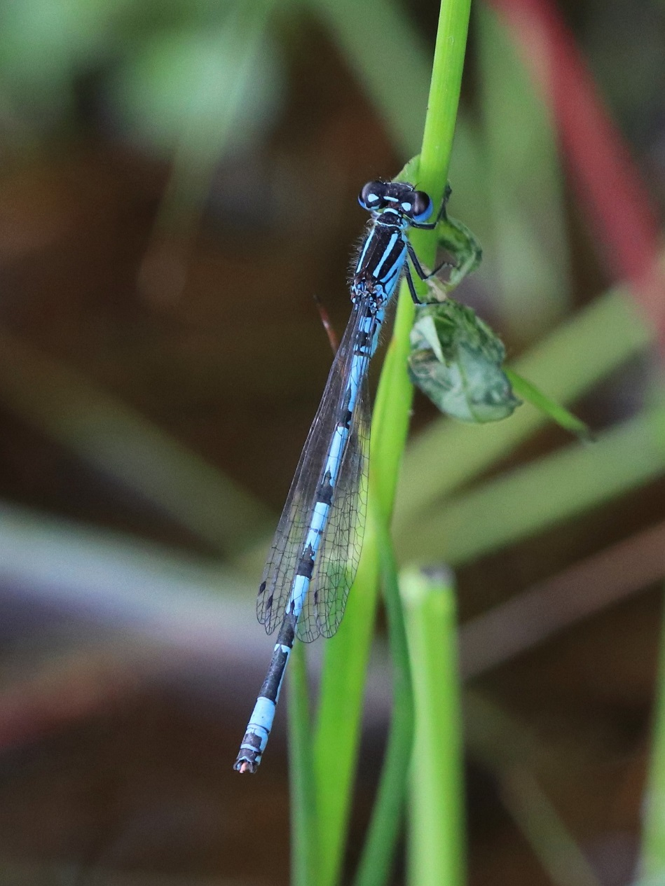
Conservation Case Study: BDS
Conservation method 1:
Legal protection for species and their habitat.
Example:
Southern Damselfly is protected under the
Wildlife and Countryside Act 1981 and has its
own Species Action Plan as it has been identified
as a priority species for conservation action.
©Dave Smallshire
Notes:
Notes:
Southern Damselfly:
This species is protected under Schedule 5 of the 1981 Wildlife and Countryside Act, as amended, which protects it against a variety of factors including killing or selling of individuals and damage or destruction of habitat.
In Great Britain this species is classified as Rare (category 3) on the Red Data Book List (it also features on the red list of other Countries in Europe), and it is a British Dragonfly Society “Priority Species".
The UK Biodiversity Steering Group published the UK Biodiversity Action Plan (BAP) in 1995. This identified the Southern Damselfly as a priority species for conservation action and included (Volume 2, page 132) a Species Action Plan (SAP) for the species. More information is available http://jncc.defra.gov.uk/page-5169 The UK BAP accords with and implements the UN Convention on Biological Diversity, signed at the Rio Earth Summit in 1992. Its overall goal is to conserve and enhance biological diversity within the UK and to contribute to the conservation of global biodiversity.

Slide 51
Conservation Case Study: BDS
Conservation method 2:
Reintroduction projects.
Example:
White-faced Darter were almost extinct in England.
Their habitat was restored at Foulshaw Moss nature reserve in Cumbria, then larvae and eggs were introduced to the new pools from a nearby donor site.
© David Turrell

Slide 52
Conservation Case Study: BDS
Conservation method 3:
Research and monitoring.
Improves our understanding of species so we can better protect them.
Example:
Clubtail Count Project trains volunteers to survey rivers looking for sites where this rare species breeds.
©Gareth Tonks
Notes:
Notes: Clubtail Count – a citizen science project to train volunteers to survey Clubtail Dragonflies on certain rivers in the South and Southwest of England. More details on our website: https://british-dragonflies.org.uk/content/clubtail-count

Slide 53
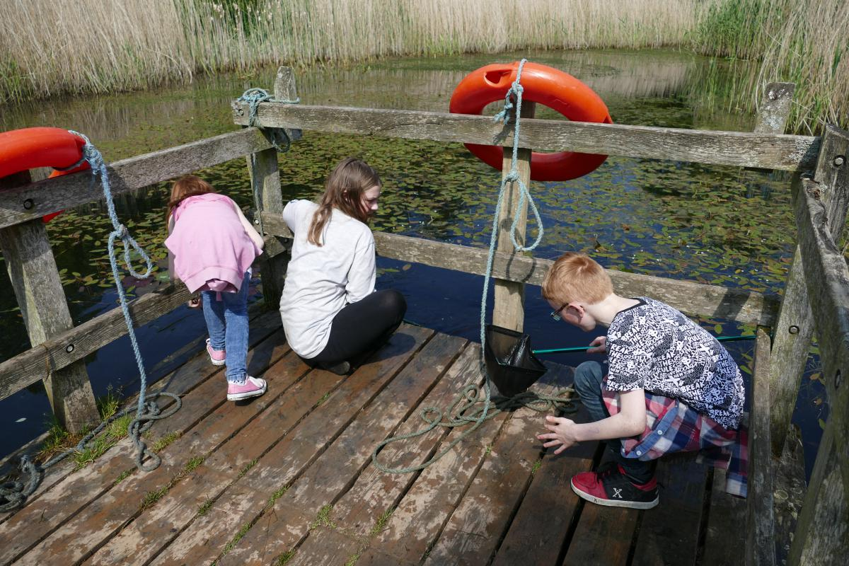
Conservation Case Study: BDS
Conservation method 4:
Education.
Teach the public about species and their importance to increase support for their conservation.
Example:
Dragonfly Hotspots Project. Centres set up around the country on nature reserves and country parks, where people can see and learn all about Dragonflies!
Notes:
Notes: To find out where your nearest Dragonfly Hotspot is take a look on our website: https://british-dragonflies.org.uk/content/england-and-wales-dragonfly-hotspots-project

Slide 54
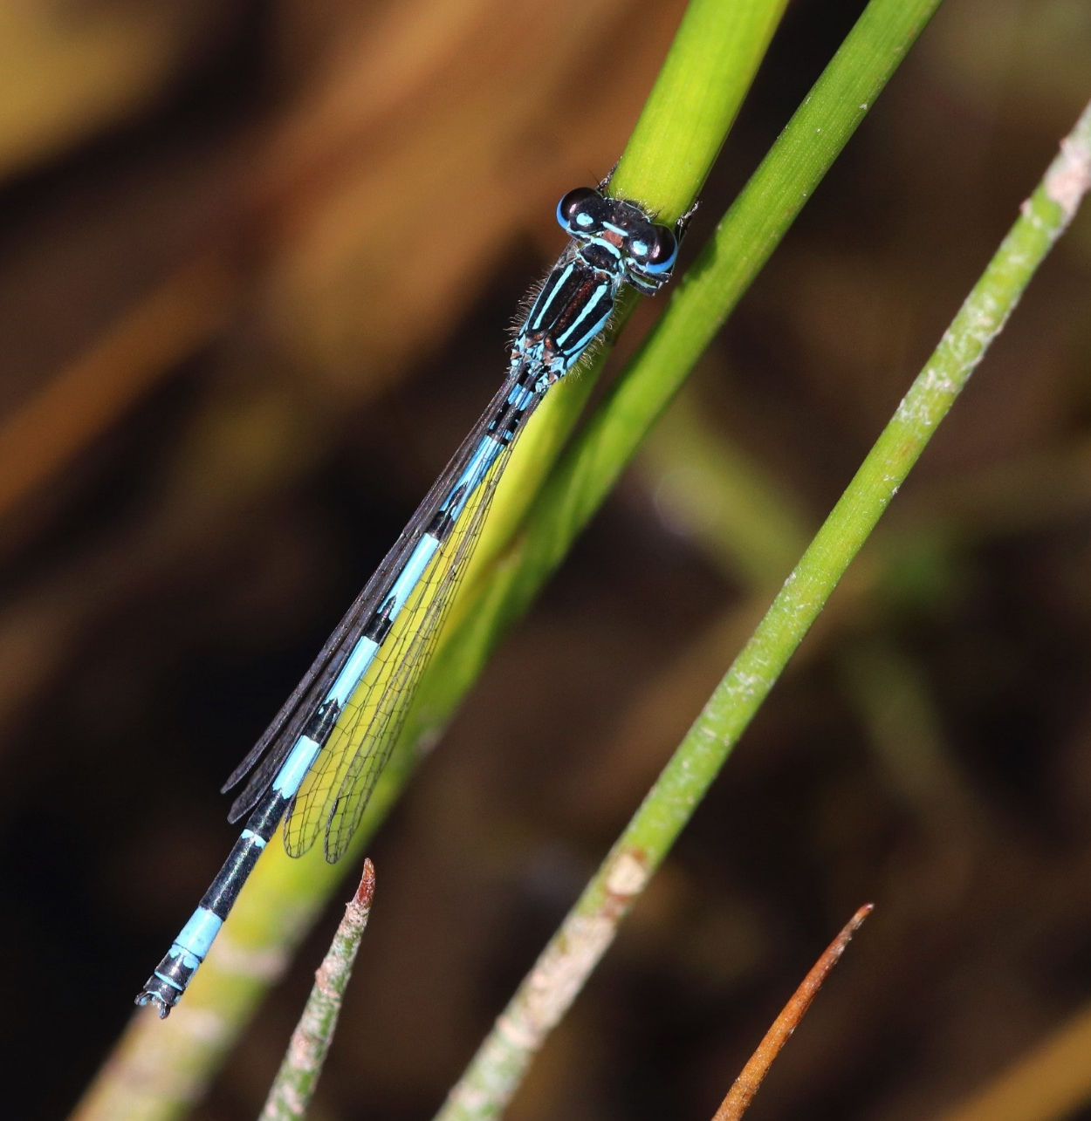
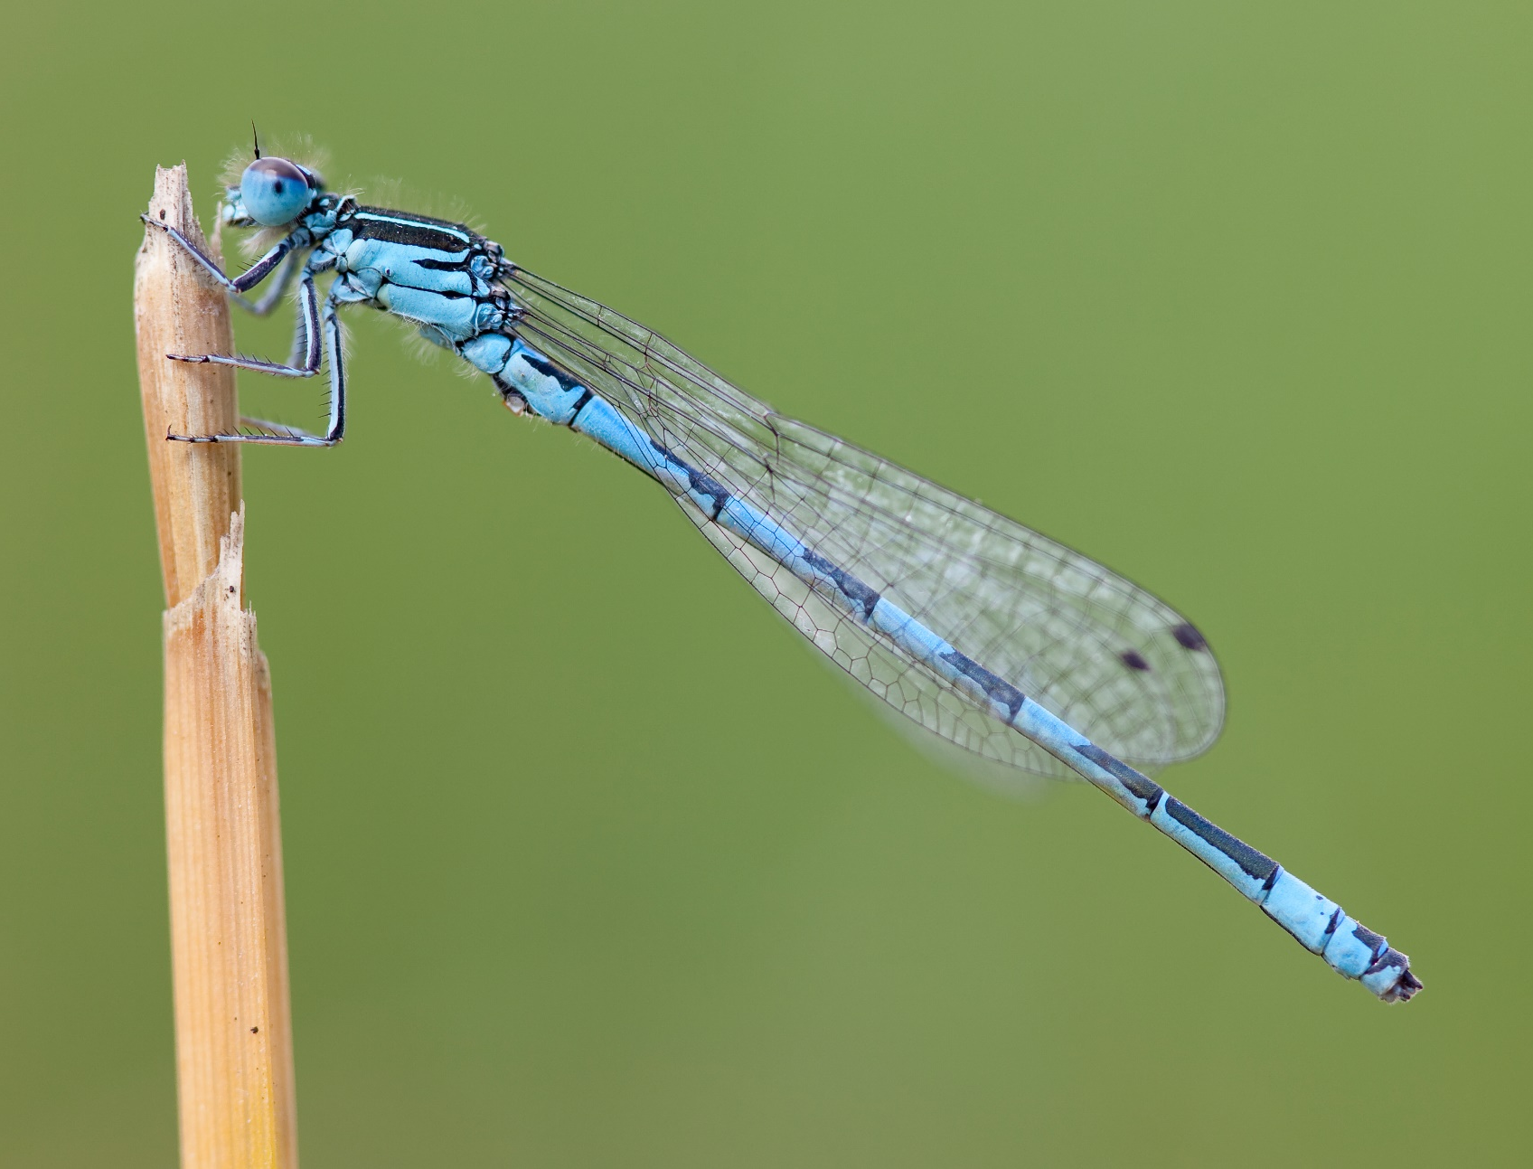
Activity 5: Southern Damselflies Case Study
©Dave Smallshire
©Christophe Brochard
Notes:
Notes: Ask students if they remember what conservation status the Southern Damselfly is? Endangered in England.

Slide 55
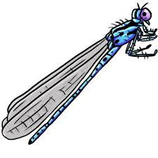
Activity 5: Southern Damselflies Case Study
In small groups: research the threats that led to the decline of the Southern Damselfly. Make a note of these to help with this activity.
Write on your map printout, or draw a sketch on a piece of paper to indicate:
1. Which threats are present in which places on the map (e.g. loss of habitat from development near cities).
2. What actions would be needed to mitigate these threats (e.g. creating more habitat elsewhere).
3. How might you go about carrying out these actions ( tip – think about who you would need to work with and how you might get any work funded)
Notes:
Notes: The Southern Damselfly is a rare species in the UK. In the UK, it is living on the extreme north-western fringe of its European range. Its two main strongholds are in the New Forest, Hampshire and the Preseli mountains, Pembrokeshire. Smaller colonies are found in Devon, Dorset, Anglesey, Gower, Oxfordshire and on the flood plains of the Test and Itchen rivers in Hampshire. There are old records from Cornwall and Somerset and elsewhere in Devon, Dorset and South Wales. The range of the species has contracted in the last thirty years.
The main factor thought to be influencing the decline of the species is the removal of grazing animals that maintain the open nature of the species' breeding sites. Other potential threats are abstraction of water, leading to a lowering of the water table, drainage due to agricultural and forestry pressures, and excessive nutrient enrichment from the runoff of nitrogenous fertilisers from adjacent agricultural land. Isolation and scarcity of habitats is a cause for concern.
Females of the Coenagrion species are very similar making them difficult to identify – are they being under recorded due to this?
The flight is weak and low; they stay close to the breeding site and do not appear to disperse easily to colonise new areas – another factor linked to their decline.
More information: https://british-dragonflies.org.uk/species/southern-damselfly
And here: http://publications.naturalengland.org.uk/publication/76020

Slide 56
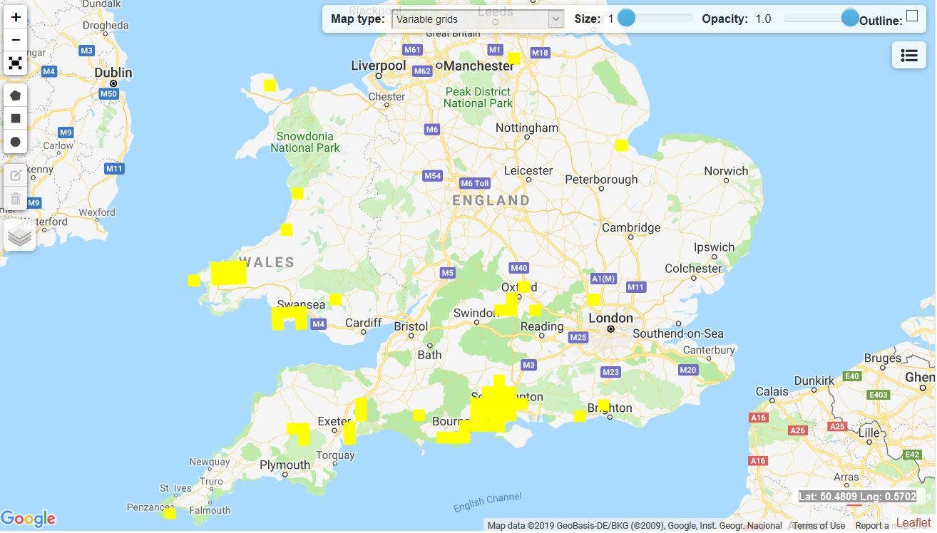
Activity 5: Southern Damselflies Case Study
Notes:
Notes: The Southern Damselfly is a rare species in the UK. In the UK, it is living on the extreme north-western fringe of its European range. Its two main strongholds are in the New Forest, Hampshire and the Preseli mountains, Pembrokeshire. Smaller colonies are found in Devon, Dorset, Anglesey, Gower, Oxfordshire and on the flood plains of the Test and Itchen rivers in Hampshire. There are old records from Cornwall and Somerset and elsewhere in Devon, Dorset and South Wales. The range of the species has contracted in the last thirty years.
The main factor thought to be influencing the decline of the species is the removal of grazing animals that maintain the open nature of the species' breeding sites. Other potential threats are abstraction of water, leading to a lowering of the water table, drainage due to agricultural and forestry pressures, and excessive nutrient enrichment from the runoff of nitrogenous fertilisers from adjacent agricultural land. Isolation and scarcity of habitats is a cause for concern.
Females of the Coenagrion species are very similar making them difficult to identify – are they being under recorded due to this?
The flight is weak and low; they stay close to the breeding site and do not appear to disperse easily to colonise new areas – another factor linked to their decline.

Slide 57
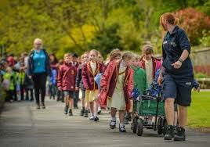
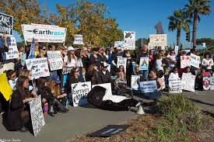
Conservation
Plan B – If conservation in the wild is failing and a species is at risk of going extinct what can you do?
Use Zoological Parks and Conservation Centres
Benefits?
Zoos have educational value and help people to learn about species and their conservation. Captive breeding programmes can be very successful.
Issues?
Ethics of keeping animals captive- especially highly intelligent species, those with naturally large territories and migratory species.
Costly to run, especially with large animals.
Not all animals can breed or even survive in captivity, such as dragonflies
©Chester Zoo
©obrag.org
Notes:
Notes: Top photo is the well respected conservation institute, Chester Zoo, education programme. Bottom photo shows protestors outside Seaworld in the USA., who oppose intelligent Orca’s being kept in small tanks and made to perform for the entertainment of visitors.
Ask the students what they think, even ask them to discuss this for a few minutes with the person next to them.

Slide 58
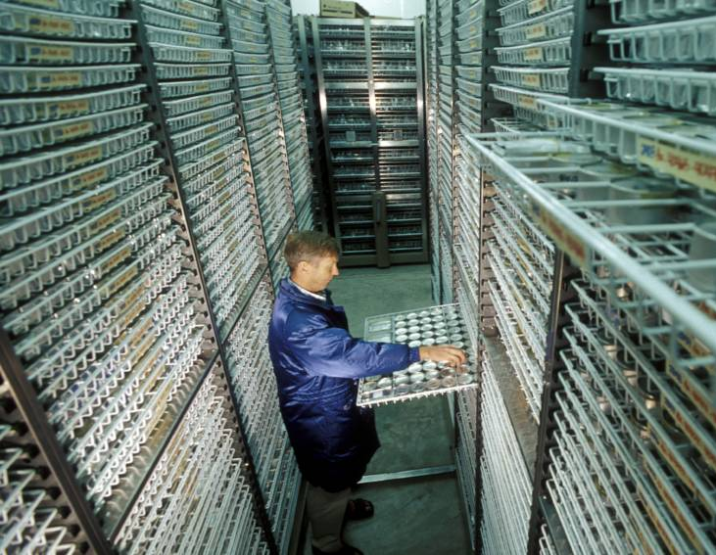
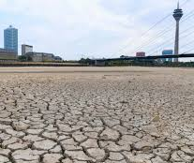
Conservation
Plan B – If conservation in the wild is failing and a species is at risk of going extinct what else can you do?
Use Gene Banks
Gene Banks are stores of genetic material of species, used as an insurance policy - in the case of a species extinction the materials could be used to ‘revive’ the species.
Benefits?
For plants it is cheaper than growing species in captivity (ex situ).
Takes up less room than having to keep specimens in captivity.
Issues?
If a species habitat is completely destroyed having genetic material won’t matter - you can’t introduce it back into the wild.
Very expensive to collect and store sperm and eggs from mammals.
Not possible to use gene banks for insects currently.
©scidev.net
©metro.co.uk
Notes:
Notes: Ask students if they can think of any examples of well known gene bank projects? E.g. Kew Gardens Millennium Seedbank, Doomsday seed vault in Norway.

Slide 59
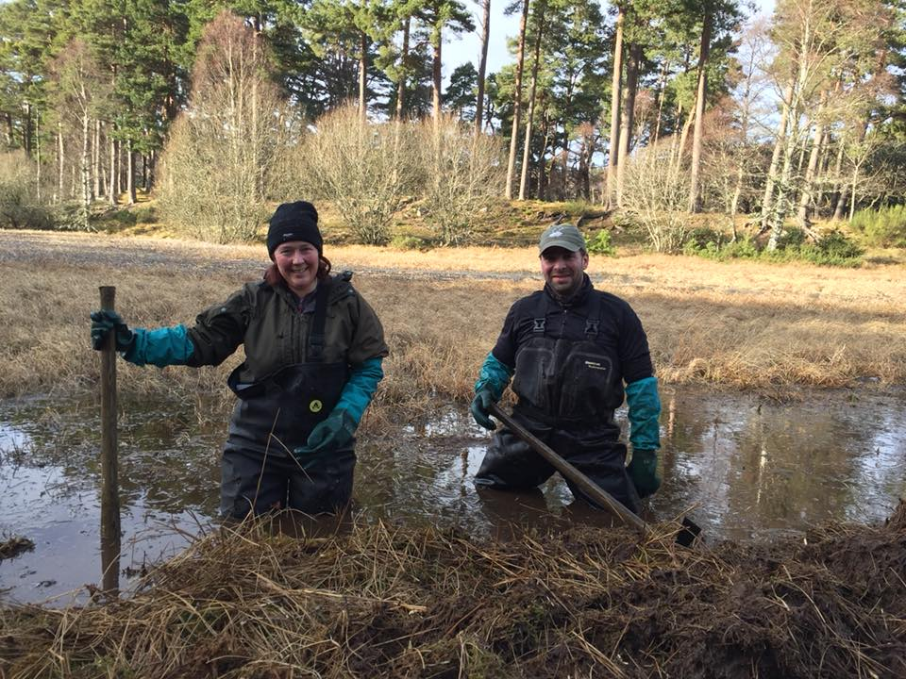
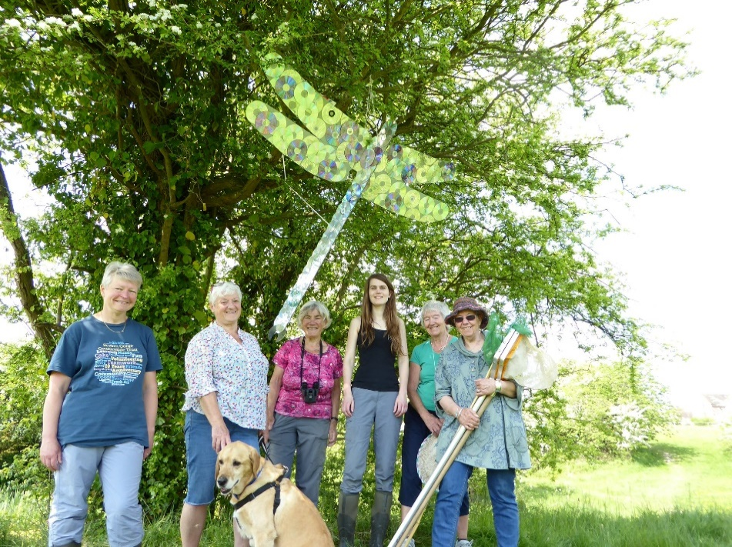
Activity 6: Making A Home For Dragonflies
Gene Banks and Zoos are not currently suitable methods for conserving dragonflies and damselflies. We need to focus on habitat restoration, creating new habitat and raising awareness so that more people will help with this too.
Draw a garden you know well, either one at home or in your school grounds or at a local park. Be sure to capture all features, noting down where grass, trees, paths, buildings etc. are.
Make a note of any habitat that you think is suitable for dragonflies and damselflies to live in and explain why.
Enhance this existing habitat, or design some new habitat by drawing in some dragonfly friendly features.
Could you create any of these habitats in real life in your garden and school grounds?
Notes:
Notes: Hand out the British Dragonfly Society ‘Garden Pond’ leaflet to help students with this activity. Let the students offer suggestions after asking what they think we should focus on in order to conserve dragonflies.

Slide 60
Conservation
Conclusions
Dragonflies cannot easily be bred in captivity.
Gene banks are not a suitable method to conserve them either.
Therefore the British Dragonfly Society focuses activities on:
Habitat management and creation to ensure that populations can move in response to environmental pressures and climatic changes
Ensuring the habitat of legally protected and threatened species is preserved and managed properly.
Supporting research to improve our understanding of dragonflies and how to conserve them.
Letting everyone know why dragonflies are amazing and are worth saving. Dispelling negative myths that people may believe about them and highlighting their positive cultural associations.
Training lots of people to identify and monitor dragonflies so that we have an accurate picture of how populations are faring.
Encouraging everyone to build ponds in their gardens and schools, not to use pesticides, and to enjoy and care for dragonflies.
©Christophe Brochard
Notes:
Notes: Hand out British Dragonfly Society ‘Dragonflies and Damselflies of the Garden’ leaflet to all students to take home and learn more.

Slide 61
We hope that you now love dragonflies as much as we do and want to help us save them! Visit our website to get involved! www.british-dragonflies.org.uk
©Christophe Brochard

